Slide 1
Matching and Self organizing Networks
By
Varun Deshmukh
Assistant Professor,
Department of Computer Engineering,
MPSTME, Shirpur Campus

Slide 2
Introduction
In this chapter, the study is made on the second major learning paradigm-unsupervised learning. In this learning, there exists no feedback from the system (environment) to indicate the desired outputs of a network.
The network by itself should discover any relationships of interest, such as features, patterns, contours, correlations or categories, classifications in the input data, and thereby translate the discovered relationships into outputs.
Such networks are also called self-organizing networks. An unsupervised learning can judge how similar a new input pattern is to typical patterns already seen, and the network gradually learns what similarity is; the network may construct a set of axes along which to measure similarity to previous patterns, i.e., it performs principal component analysis, clustering, adaptive vector quantization and feature mapping.
For example, when net has been trained to classify the input patterns inro any one of the output classes, say, P, Q, R, S or T, the net may respond to both the classes, P and Q or R and S.

Slide 3
Introduction
In the case mentioned, only one of several neurons should fire, i.e., respond. Hence the network has an added structure by means of which the net is forced to make a decision, so that only one unit will respond. The process for achieving this is called competition.
Practically, considering a set of students, if we want to classify them on the basis of evaluation performance, their score may be calculated, and the one whose score is higher than the others should be the winner.
The same principle adopted here is followed in the neural networks for pattern classification. In this case, there may exist a tie; a suitable solution is presented even when a tie occurs.
Hence these nets may also be called competitive nets, The extreme form of these competitive nets is called winner-takes-all. The name itself implies that only one neuron in the competing group will possess a nonzero output signal at the end of competition.

Slide 4
Introduction
There exist several neural networks that come under this category. To list out a few: Maxnet, Mexican hat, Hamming net, Kohonen self-organizing feature map, counter propagation net, learning vector quantization (LVQ) and adaptive resonance theory (ART).
In the case of unsupervised learning, the net seeks to find patterns or regularity in the input data by forming clusters. ART networks are called clustering nets.
In these types of clustering nets, there are as many input units as an input vector possessing components. Since each output unit represents a cluster, the number of output units will limit the number of clusters that can be formed.
The learning algorithm used in most of these nets is known as Kohonen learning. In this learning, the units update their weights by forming a new weight vector which is a linear combination of the old weight vector and the new input vector.

Slide 6
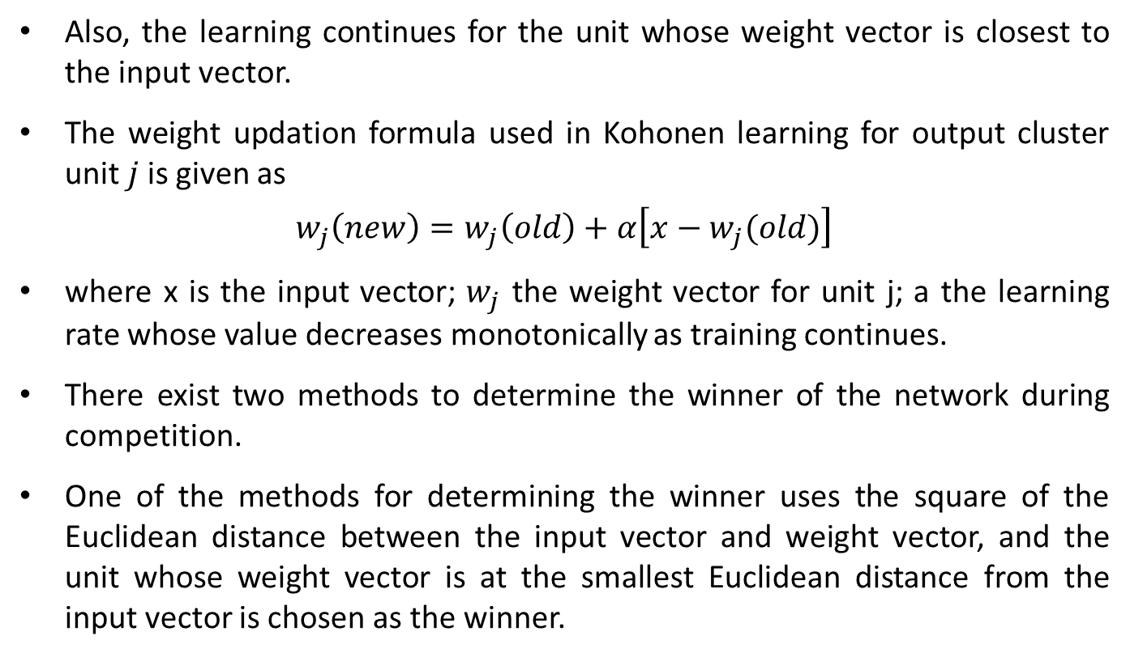
Introduction
Also, the learning continues for the unit whose weight vector is closest to the input vector.
The weight updation formula used in Kohonen learning for output cluster unit $j$is given as
$$w_{j}\left(new\right)=w_{j}\left(old\right)+α\left[x−w_{j}(old)\right]$$
where x is the input vector; $w_{j}$ the weight vector for unit j; a the learning rate whose value decreases monotonically as training continues.
There exist two methods to determine the winner of the network during competition.
One of the methods for determining the winner uses the square of the Euclidean distance between the input vector and weight vector, and the unit whose weight vector is at the smallest Euclidean distance from the input vector is chosen as the winner.

Slide 7
Introduction
The next method uses the dot product of the input vector and weight vector.
The dot product between the input vector and weight vector is nothing but the net inputs calculated for the corresponding cluster units.
The unit with the largest dot product is chosen as the winner and the weight updation is performed over it because the one with largest dot product corresponds to the smallest angle between the input and weight vectors, if both are of unit length.
Both the methods can be applied for vectors of unit length. But generally, to avoid normalization of the input and weight vectors, the square of the Euclidean distance may be used.

Slide 8
Fixed Weight Competitive Nets
These competitive nets are those where the weights remain fixed, even during training process.
The idea of competition is used among neurons for enhancement of contrast in their activation functions.
In this section, three nets- Maxnet, Mexican hat and Hamming net- are discussed in detail.

Slide 9
Maxnet
In 1987, Lippmann developed the Maxnet which is an example for a neural net based on competition.
The Maxnet serves as a sub net for picking the node whose input is larger.
All the nodes present in this subnet are fully interconnected and there exist symmetrical weights in all these weighted interconnections.
As such, there is no specific algorithm to train Maxnet; the weights are fixed in this case.

Slide 10
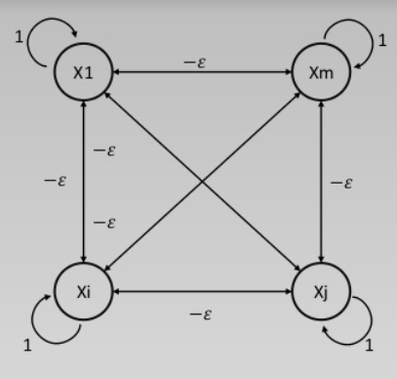
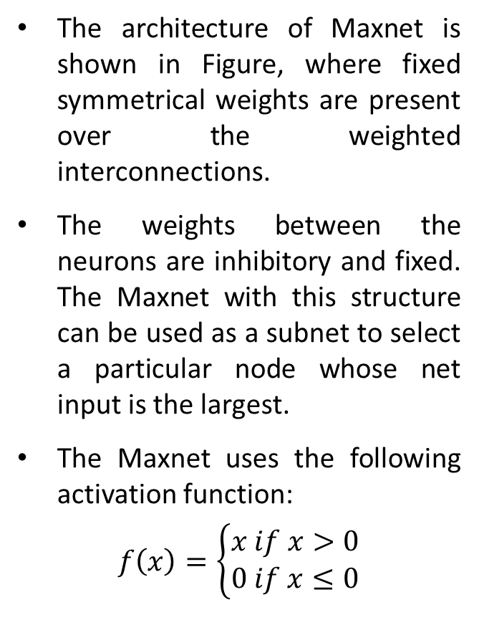
Architecture of Maxnet
The architecture of Maxnet is shown in Figure, where fixed symmetrical weights are present over the weighted interconnections.
The weights between the neurons are inhibitory and fixed. The Maxnet with this structure can be used as a subnet to select a particular node whose net input is the largest.
The Maxnet uses the following activation function:
$$f\left(x\right)=\left\{\begin{matrix}x if x>0 \\ 0 if x≤0\end{matrix}\right.$$

Slide 11
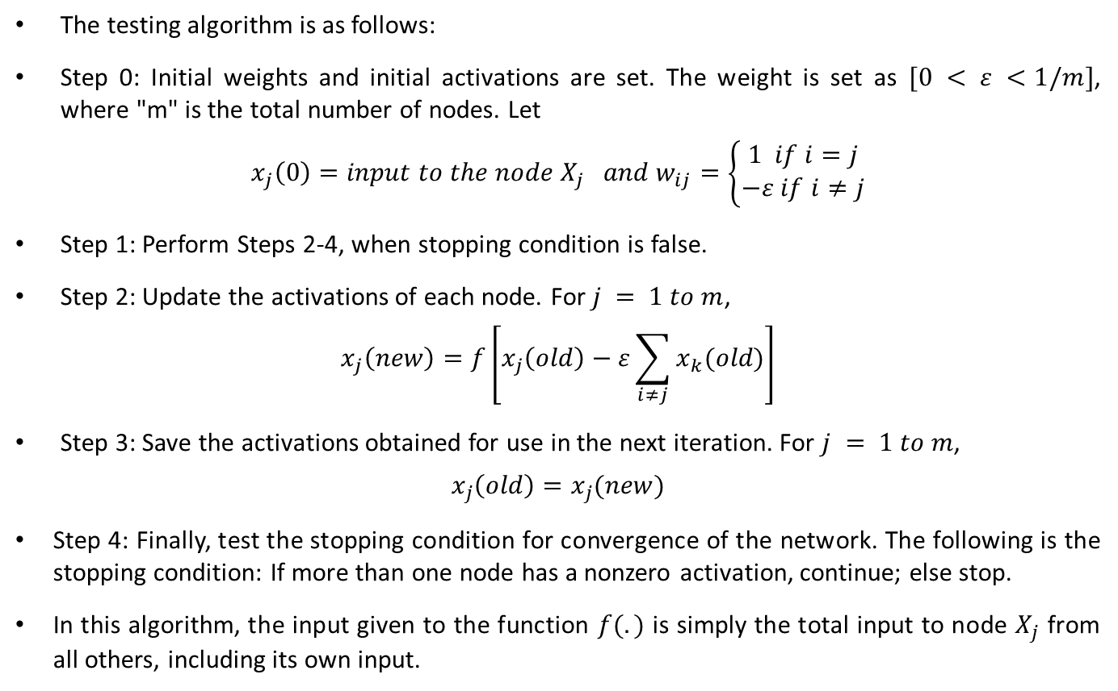
Testing/Application Algorithm of Maxnet
The testing algorithm is as follows:
Step 0: Initial weights and initial activations are set. The weight is set as $[0 < ε <1/m]$, where "m" is the total number of nodes. Let
$$x_{j}\left(0\right)=input to the node X_{j} and w_{ij}=\left\{\begin{matrix}1 if i=j \\ −ε if i≠j\end{matrix}\right.$$
Step 1: Perform Steps 2-4, when stopping condition is false.
Step 2: Update the activations of each node. For $j = 1 to m$,
$$x_{j}\left(new\right)=f\left[x_{j}\left(old\right)−ε\sum_{i≠j}{x_{k}(old)}\right]$$
Step 3: Save the activations obtained for use in the next iteration. For $j = 1 to m$,
$$x_{j}\left(old\right)=x_{j}(new)$$
Step 4: Finally, test the stopping condition for convergence of the network. The following is the stopping condition: If more than one node has a nonzero activation, continue; else stop.
In this algorithm, the input given to the function $f(.)$ is simply the total input to node $X_{j}$ from all others, including its own input.

Slide 12
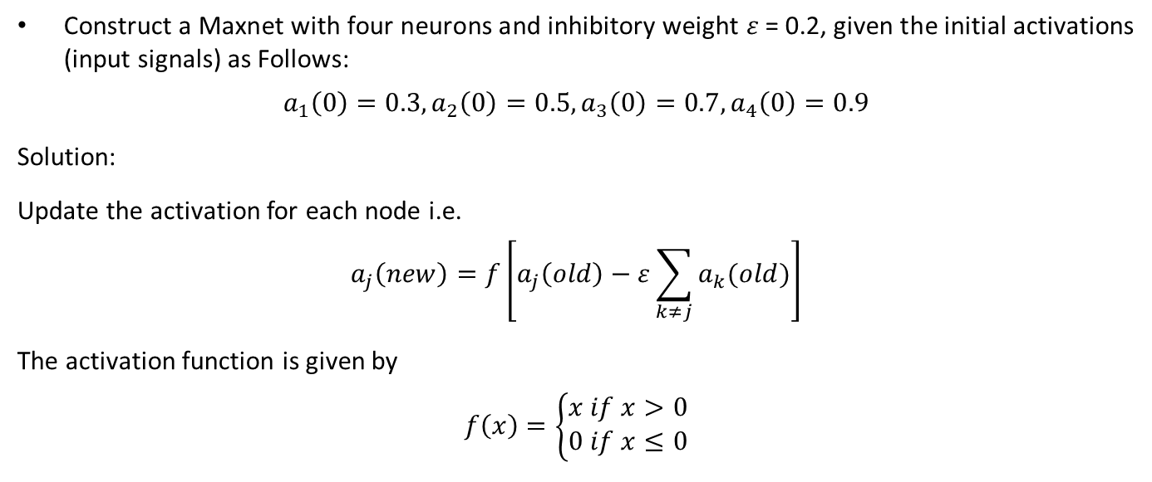
Example
Construct a Maxnet with four neurons and inhibitory weight $ε$ = 0.2, given the initial activations (input signals) as Follows:
$$a_{1}\left(0\right)=0.3, a_{2}\left(0\right)=0.5, a_{3}\left(0\right)=0.7, a_{4}\left(0\right)=0.9$$
Solution:
Update the activation for each node i.e.
$$a_{j}\left(new\right)=f\left[a_{j}\left(old\right)−ε\sum_{k≠j}{a_{k}(old)}\right]$$
The activation function is given by
$$f\left(x\right)=\left\{\begin{matrix}x if x>0 \\ 0 if x≤0\end{matrix}\right.$$

Slide 17
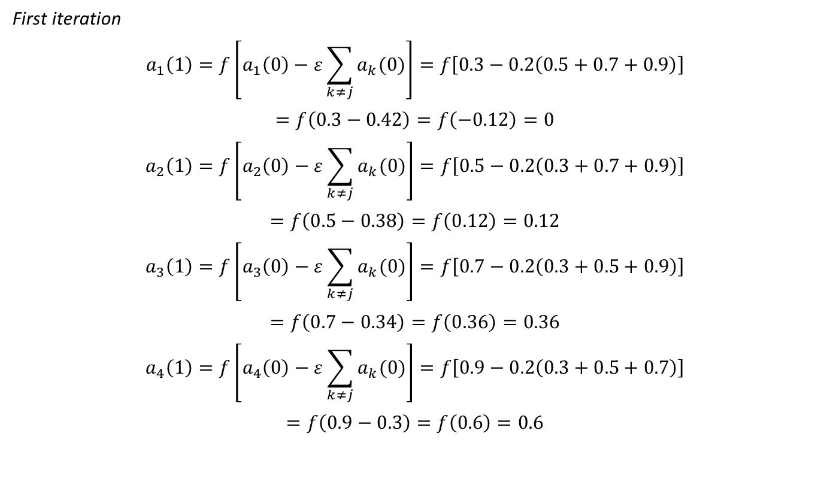
Example
First iteration
$$a_{1}\left(1\right)=f\left[a_{1}\left(0\right)−ε\sum_{k≠j}{a_{k}(0)}\right]=f\left[0.3−0.2\left(0.5+0.7+0.9\right)\right]$$
$$=f\left(0.3−0.42\right)=f\left(−0.12\right)=0$$
$$a_{2}\left(1\right)=f\left[a_{2}\left(0\right)−ε\sum_{k≠j}{a_{k}(0)}\right]=f\left[0.5−0.2\left(0.3+0.7+0.9\right)\right]$$
$$=f\left(0.5−0.38\right)=f\left(0.12\right)=0.12$$
$$a_{3}\left(1\right)=f\left[a_{3}\left(0\right)−ε\sum_{k≠j}{a_{k}(0)}\right]=f\left[0.7−0.2\left(0.3+0.5+0.9\right)\right]$$
$$=f\left(0.7−0.34\right)=f\left(0.36\right)=0.36$$
$$a_{4}\left(1\right)=f\left[a_{4}\left(0\right)−ε\sum_{k≠j}{a_{k}(0)}\right]=f\left[0.9−0.2\left(0.3+0.5+0.7\right)\right]$$
$$=f\left(0.9−0.3\right)=f\left(0.6\right)=0.6$$

Slide 18
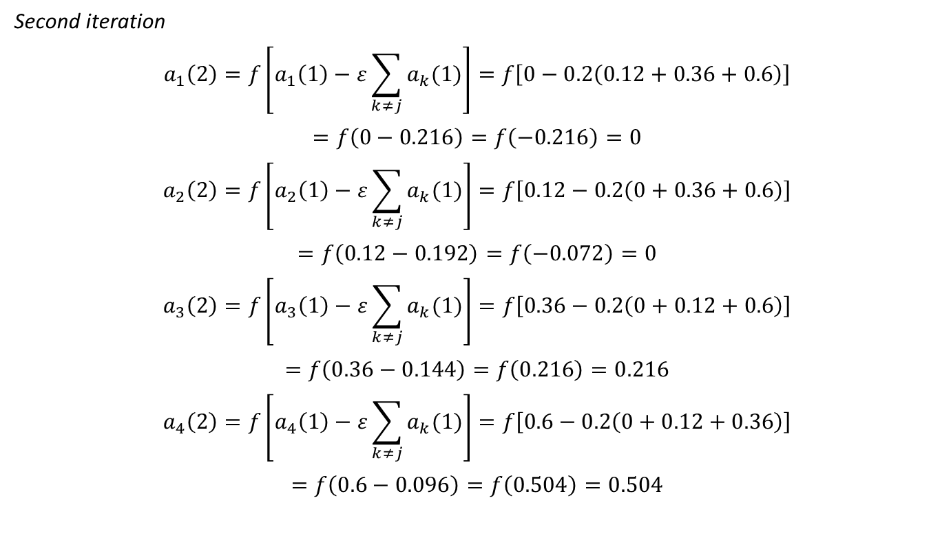
Example
Second iteration
$$a_{1}\left(2\right)=f\left[a_{1}\left(1\right)−ε\sum_{k≠j}{a_{k}(1)}\right]=f\left[0−0.2\left(0.12+0.36+0.6\right)\right]$$
$$=f\left(0−0.216\right)=f\left(−0.216\right)=0$$
$$a_{2}\left(2\right)=f\left[a_{2}\left(1\right)−ε\sum_{k≠j}{a_{k}(1)}\right]=f\left[0.12−0.2\left(0+0.36+0.6\right)\right]$$
$$=f\left(0.12−0.192\right)=f\left(−0.072\right)=0$$
$$a_{3}\left(2\right)=f\left[a_{3}\left(1\right)−ε\sum_{k≠j}{a_{k}(1)}\right]=f\left[0.36−0.2\left(0+0.12+0.6\right)\right]$$
$$=f\left(0.36−0.144\right)=f\left(0.216\right)=0.216$$
$$a_{4}\left(2\right)=f\left[a_{4}\left(1\right)−ε\sum_{k≠j}{a_{k}(1)}\right]=f\left[0.6−0.2\left(0+0.12+0.36\right)\right]$$
$$=f\left(0.6−0.096\right)=f\left(0.504\right)=0.504$$

Slide 19
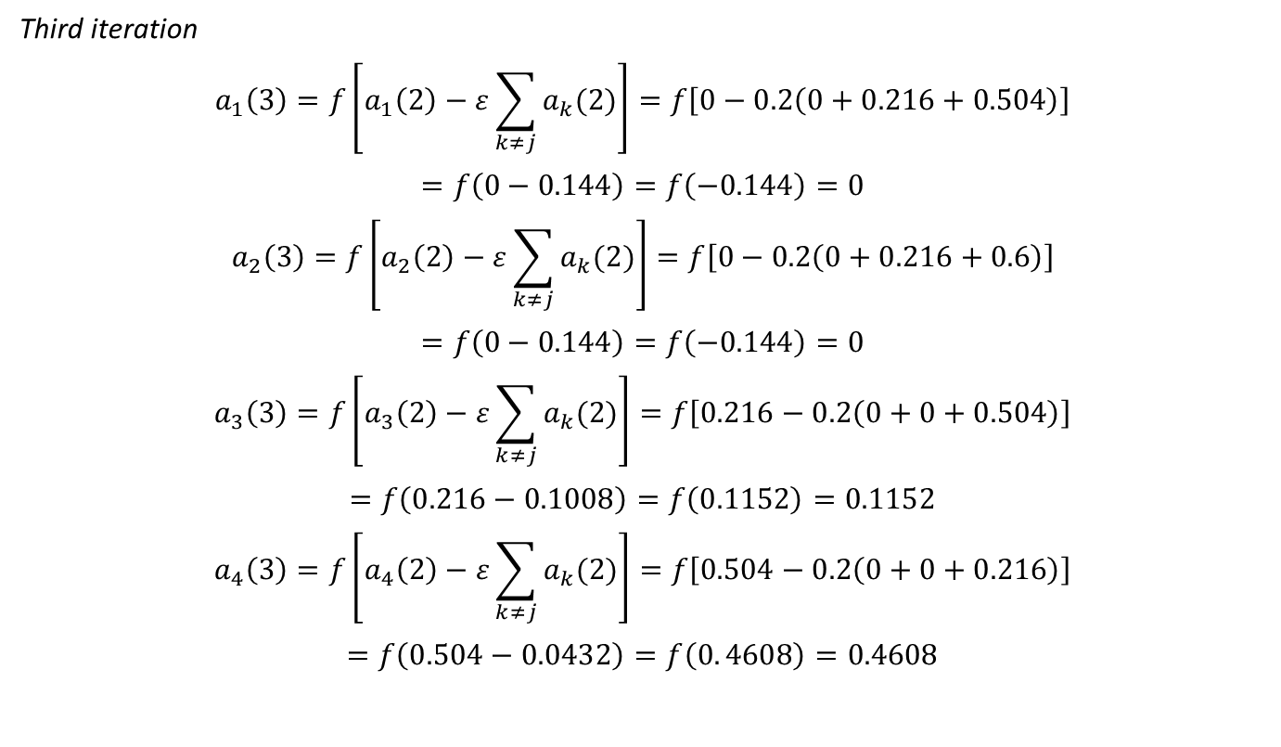
Example
Third iteration
$$a_{1}\left(3\right)=f\left[a_{1}\left(2\right)−ε\sum_{k≠j}{a_{k}(2)}\right]=f\left[0−0.2\left(0+0.216+0.504\right)\right]$$
$$=f\left(0−0.144\right)=f\left(−0.144\right)=0$$
$$a_{2}\left(3\right)=f\left[a_{2}\left(2\right)−ε\sum_{k≠j}{a_{k}(2)}\right]=f\left[0−0.2\left(0+0.216+0.6\right)\right]$$
$$=f\left(0−0.144\right)=f\left(−0.144\right)=0$$
$$a_{3}\left(3\right)=f\left[a_{3}\left(2\right)−ε\sum_{k≠j}{a_{k}(2)}\right]=f\left[0.216−0.2\left(0+0+0.504\right)\right]$$
$$=f\left(0.216−0.1008\right)=f\left(0.1152\right)=0.1152$$
$$a_{4}\left(3\right)=f\left[a_{4}\left(2\right)−ε\sum_{k≠j}{a_{k}(2)}\right]=f\left[0.504−0.2\left(0+0+0.216\right)\right]$$
$$=f\left(0.504−0.0432\right)=f\left(0. 4608\right)=0.4608$$

Slide 20
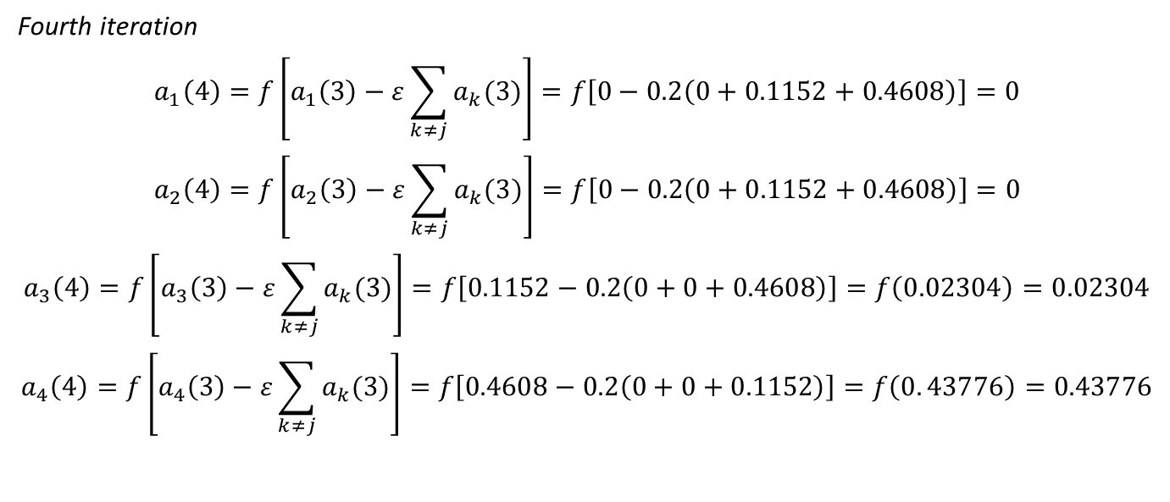
Example
Fourth iteration
$$a_{1}\left(4\right)=f\left[a_{1}\left(3\right)−ε\sum_{k≠j}{a_{k}(3)}\right]=f\left[0−0.2\left(0+0.1152+0.4608\right)\right]=0$$
$$a_{2}\left(4\right)=f\left[a_{2}\left(3\right)−ε\sum_{k≠j}{a_{k}(3)}\right]=f\left[0−0.2\left(0+0.1152+0.4608\right)\right]=0$$
$$a_{3}\left(4\right)=f\left[a_{3}\left(3\right)−ε\sum_{k≠j}{a_{k}(3)}\right]=f\left[0.1152−0.2\left(0+0+0.4608\right)\right]=f\left(0.02304\right)=0.02304$$
$$a_{4}\left(4\right)=f\left[a_{4}\left(3\right)−ε\sum_{k≠j}{a_{k}(3)}\right]=f\left[0.4608−0.2\left(0+0+0.1152\right)\right]=f\left(0. 43776\right)=0.43776$$

Slide 21
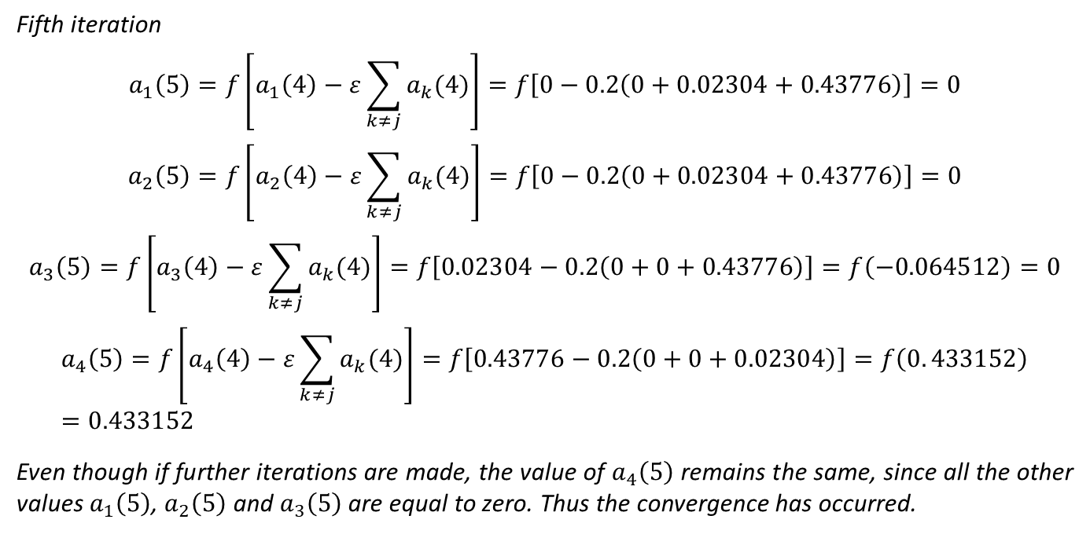
Example
Fifth iteration
$$a_{1}\left(5\right)=f\left[a_{1}\left(4\right)−ε\sum_{k≠j}{a_{k}(4)}\right]=f\left[0−0.2\left(0+0.02304+0.43776\right)\right]=0$$
$$a_{2}\left(5\right)=f\left[a_{2}\left(4\right)−ε\sum_{k≠j}{a_{k}(4)}\right]=f\left[0−0.2\left(0+0.02304+0.43776\right)\right]=0$$
$$a_{3}\left(5\right)=f\left[a_{3}\left(4\right)−ε\sum_{k≠j}{a_{k}(4)}\right]=f\left[0.02304−0.2\left(0+0+0.43776\right)\right]=f\left(−0.064512\right)=0$$
$$a_{4}\left(5\right)=f\left[a_{4}\left(4\right)−ε\sum_{k≠j}{a_{k}(4)}\right]=f\left[0.43776−0.2\left(0+0+0.02304\right)\right]=f\left(0. 433152\right)=0.433152$$
Even though if further iterations are made, the value of $a_{4}\left(5\right)$ remains the same, since all the other values $a_{1}\left(5\right)$, $a_{2}\left(5\right)$ and $a_{3}\left(5\right)$ are equal to zero. Thus the convergence has occurred.

Slide 22
Mexican Hat Net
In 1989, Kohonen developed the Mexican hat network which is a more generalized contrast enhancement network compared to the earlier Maxnet.
There exist several "cooperative neighbors" (neurons in close prox­imity) to which every other neuron is connected by excitatory links.
Also each neuron is connected over inhibitory weights to a number of "competitive neighbors" (neurons present farther away).
There are several other farther neurons to which the connections between the neurons are not established.
Here, in addition to the connections within a particular layer of neural net, the neurons also receive some other external signals.
This interconnection pattern is repeated for several other neurons in the layer.

Slide 23
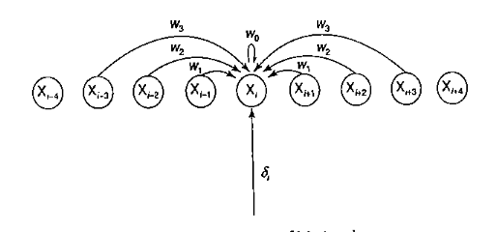
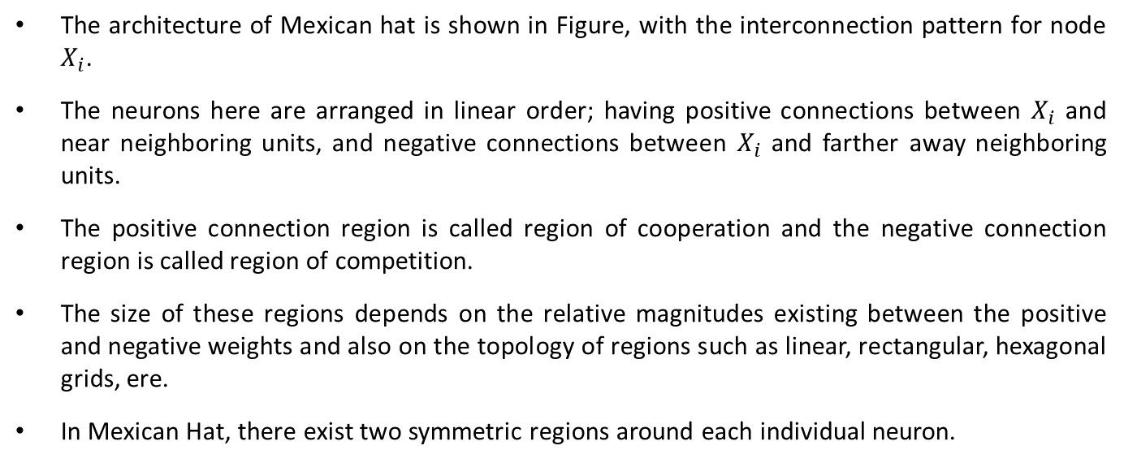
Mexican Hat Net (architecture)
The architecture of Mexican hat is shown in Figure, with the interconnection pattern for node $X_{i}$.
The neurons here are arranged in linear order; having positive connections between $X_{i}$ and near neighboring units, and negative connections between $X_{i}$ and farther away neighboring units.
The positive connection region is called region of cooperation and the negative connection region is called region of competition.
The size of these regions depends on the relative magnitudes existing between the positive and negative weights and also on the topology of regions such as linear, rectangular, hexagonal grids, ere.
In Mexican Hat, there exist two symmetric regions around each individual neuron.

Slide 24
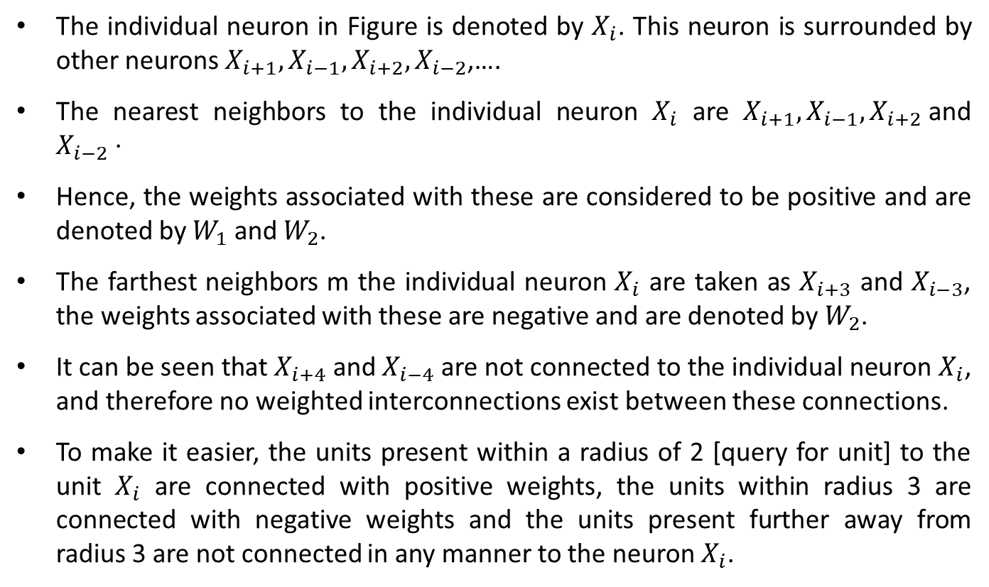
Mexican Hat Net (architecture)
The individual neuron in Figure is denoted by $X_{i}$. This neuron is surrounded by other neurons $X_{i+1}, X_{i−1},X_{i+2},X_{i−2}$,….
The nearest neighbors to the individual neuron $X_{i}$ are $X_{i+1}, X_{i−1},X_{i+2}$and $X_{i−2}$·
Hence, the weights associated with these are considered to be positive and are denoted by $W_{1}$ and $W_{2}$.
The farthest neighbors m the individual neuron $X_{i}$ are taken as $X_{i+3}$ and $X_{i−3}$, the weights associated with these are negative and are denoted by $W_{2}$.
It can be seen that $X_{i+4}$ and $X_{i−4}$ are not connected to the individual neuron $X_{i}$, and therefore no weighted interconnections exist between these connections.
To make it easier, the units present within a radius of 2 [query for unit] to the unit $X_{i}$ are connected with positive weights, the units within radius 3 are connected with negative weights and the units present further away from radius 3 are not connected in any manner to the neuron $X_{i}$.

Slide 25
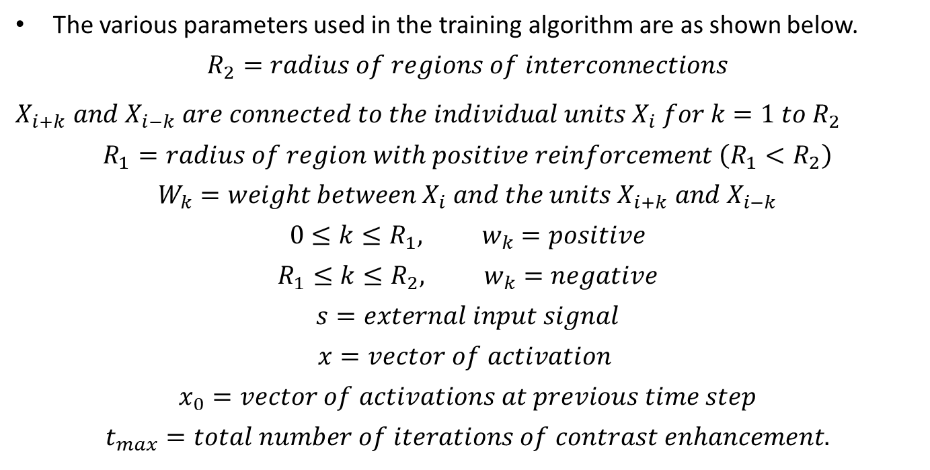
Mexican Hat Net (Algorithm)
The various parameters used in the training algorithm are as shown below.
$$R_{2}=radius of regions of interconnections$$
$X_{i+k} and$ $X_{i−k}$ $are connected to the individual units X_{i} for k=1 to R_{2}$
$$R_{1}=radius of region with positive reinforcement \left(R_{1}<R_{2}\right)$$
$$W_{k}=weight between X_{i} and the units X_{i+k} and X_{i−k}$$
$$0≤k≤R_{1}, w_{k}=positive$$
$$R_{1}≤k≤R_{2}, w_{k}=negative$$
$$s=external input signal$$
$$x=vector of activation$$
$$x_{0}=vector of activations at previous time step$$
$$t_{max}=total number of iterations of contrast enhancement.$$

Slide 26
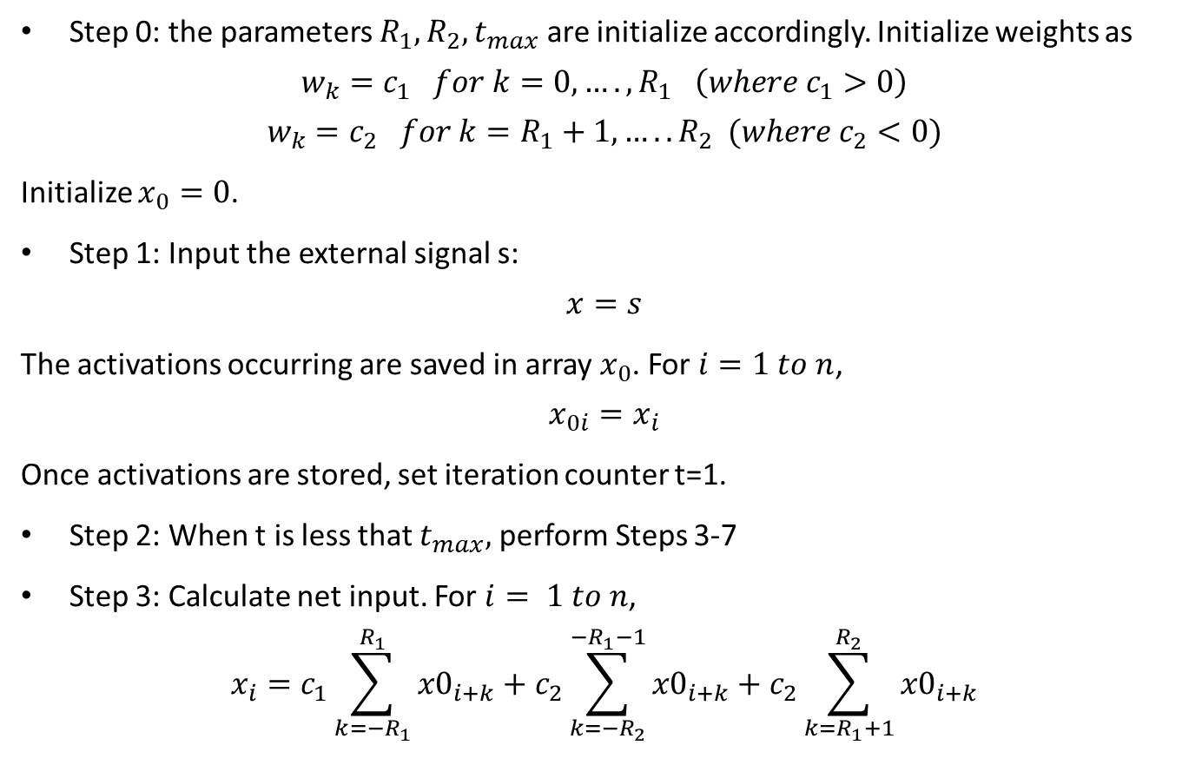
Mexican Hat Net (Algorithm)
Step 0: the parameters $R_{1}, R_{2}, t_{max}$ are initialize accordingly. Initialize weights as
$$w_{k}=c_{1} for k=0,….,R_{1} \left(where c_{1}>0\right)$$
$$w_{k}=c_{2} for k=R_{1}+1,…..R_{2} (where c_{2}<0)$$
Initialize $x_{0}=0$.
Step 1: Input the external signal s:
$$x=s$$
The activations occurring are saved in array $x_{0}$. For $i=1 to n$,
$$x_{0i}=x_{i}$$
Once activations are stored, set iteration counter t=1.
Step 2: When t is less that $t_{max},$ perform Steps 3-7
Step 3: Calculate net input. For $i= 1 to n$,
$$x_{i}=c_{1}\sum_{k=−R_{1}}^{R_{1}}{{x0}_{i+k}}+c_{2}\sum_{k=−R_{2}}^{−R_{1}−1}{{x0}_{i+k}}+c_{2}\sum_{k=R_{1}+1}^{R_{2}}{{x0}_{i+k}}$$

Slide 27
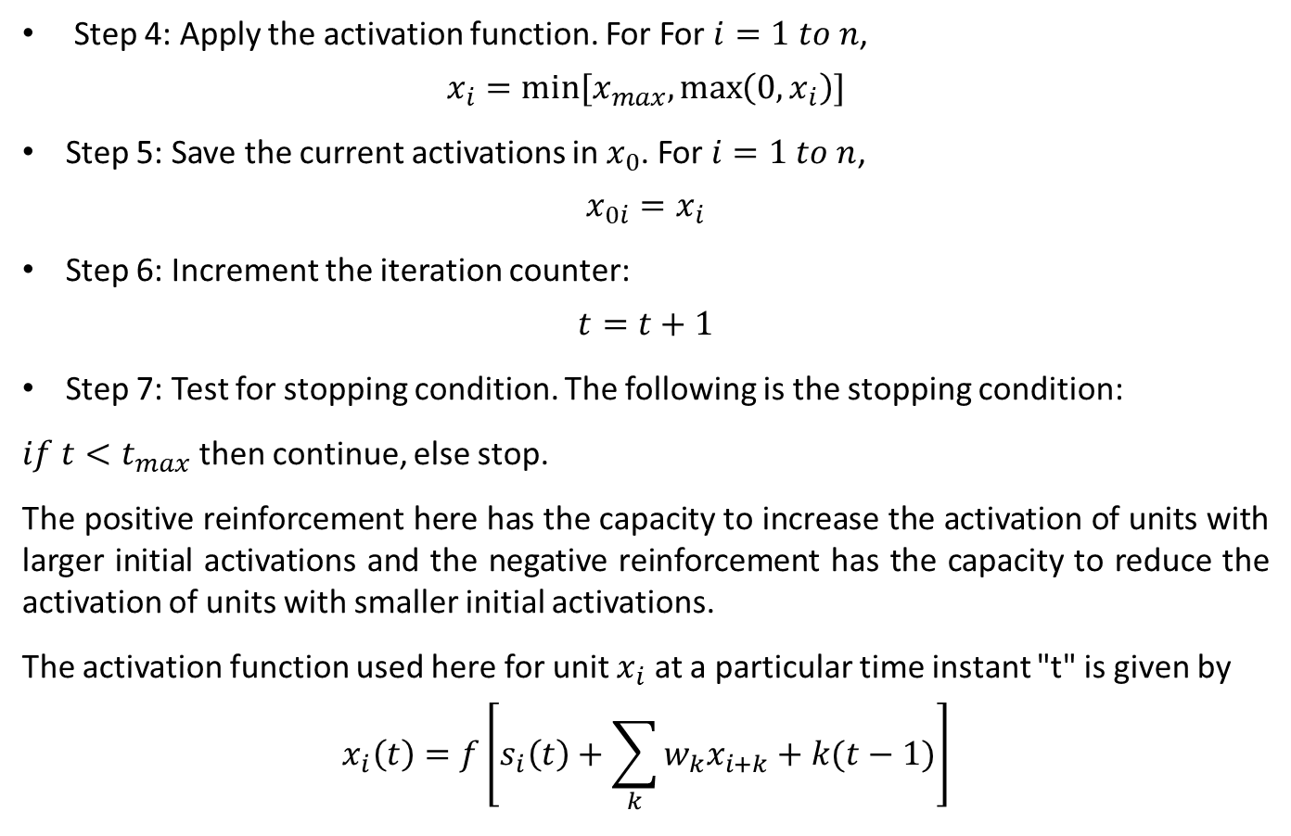
Mexican Hat Net (Algorithm)
Step 4: Apply the activation function. For For $i=1 to n$,
$$x_{i}=min⁡[x_{max},\max\left(0,x_{i}\right)]$$
Step 5: Save the current activations in $x_{0}$. For $i=1 to n$,
$$x_{0i}=x_{i}$$
Step 6: Increment the iteration counter:
$$t=t+1$$
Step 7: Test for stopping condition. The following is the stopping condition:
$if t<t_{max}$ then continue, else stop.
The positive reinforcement here has the capacity to increase the activation of units with larger initial activations and the negative reinforcement has the capacity to reduce the activation of units with smaller initial activations.
The activation function used here for unit $x_{i}$ at a particular time instant "t" is given by
$$x_{i}\left(t\right)=f\left[s_{i}\left(t\right)+\sum_{k}{w_{k}x_{i+k}}+k(t−1)\right]$$

Slide 28
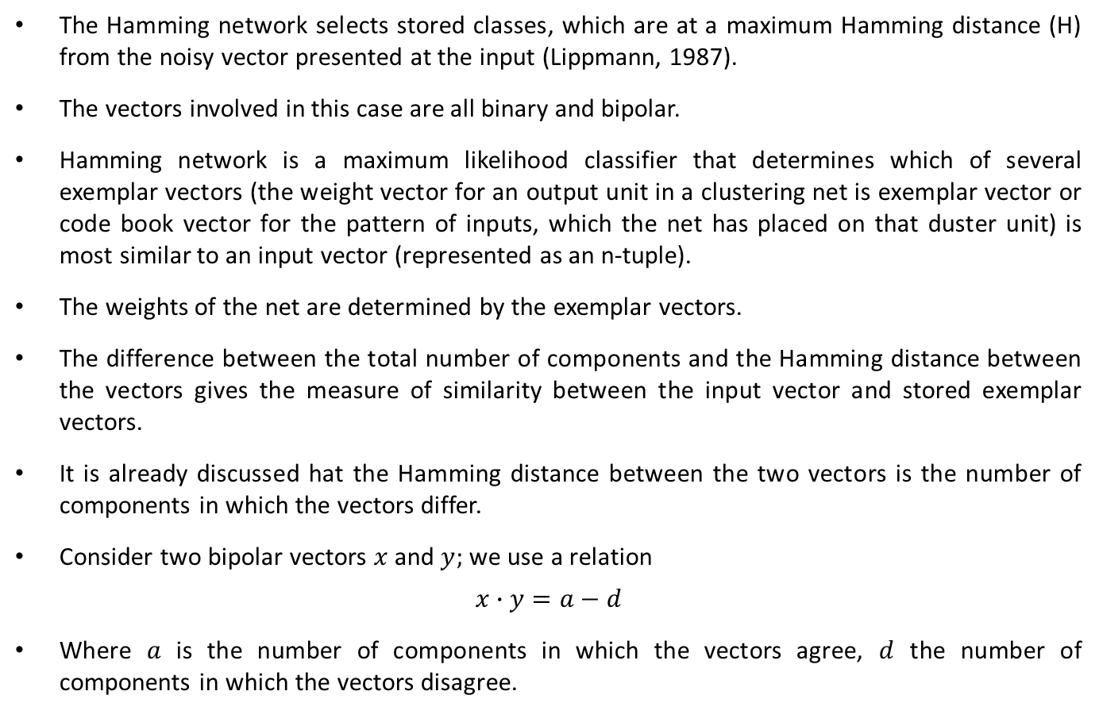
Hamming Network
The Hamming network selects stored classes, which are at a maximum Hamming distance (H) from the noisy vector presented at the input (Lippmann, 1987).
The vectors involved in this case are all binary and bipolar.
Hamming network is a maximum likelihood classifier that determines which of several exemplar vectors (the weight vector for an output unit in a clustering net is exemplar vector or code book vector for the pattern of inputs, which the net has placed on that duster unit) is most similar to an input vector (represented as an n-tuple).
The weights of the net are determined by the exemplar vectors.
The difference between the total number of components and the Hamming distance between the vectors gives the measure of similarity between the input vector and stored exemplar vectors.
It is already discussed hat the Hamming distance between the two vectors is the number of components in which the vectors differ.
Consider two bipolar vectors $x$ and $y;$ we use a relation
$$x∙y=a−d$$
Where $a$ is the number of components in which the vectors agree, $d$ the number of components in which the vectors disagree.

Slide 29
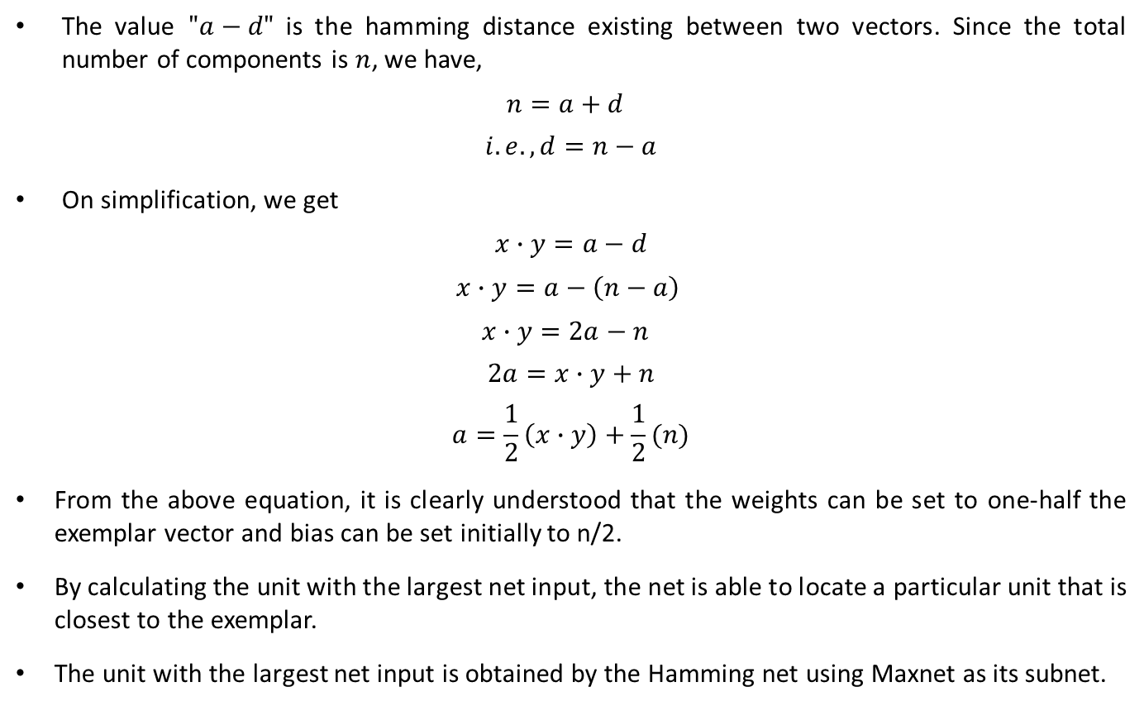
Hamming Network
The value $"a−d"$ is the hamming distance existing between two vectors. Since the total number of components is $n$, we have,
$$n=a+d$$
$$i.e., d=n−a$$
On simplification, we get
$$x∙y=a−d$$
$$x∙y=a−\left(n−a\right)$$
$$x∙y=2a−n$$
$$2a=x∙y+n$$
$$a=\frac{1}{2}\left(x∙y\right)+\frac{1}{2}(n)$$
From the above equation, it is clearly understood that the weights can be set to one-half the exemplar vector and bias can be set initially to n/2.
By calculating the unit with the largest net input, the net is able to locate a particular unit that is closest to the exemplar.
The unit with the largest net input is obtained by the Hamming net using Maxnet as its subnet.

Slide 30
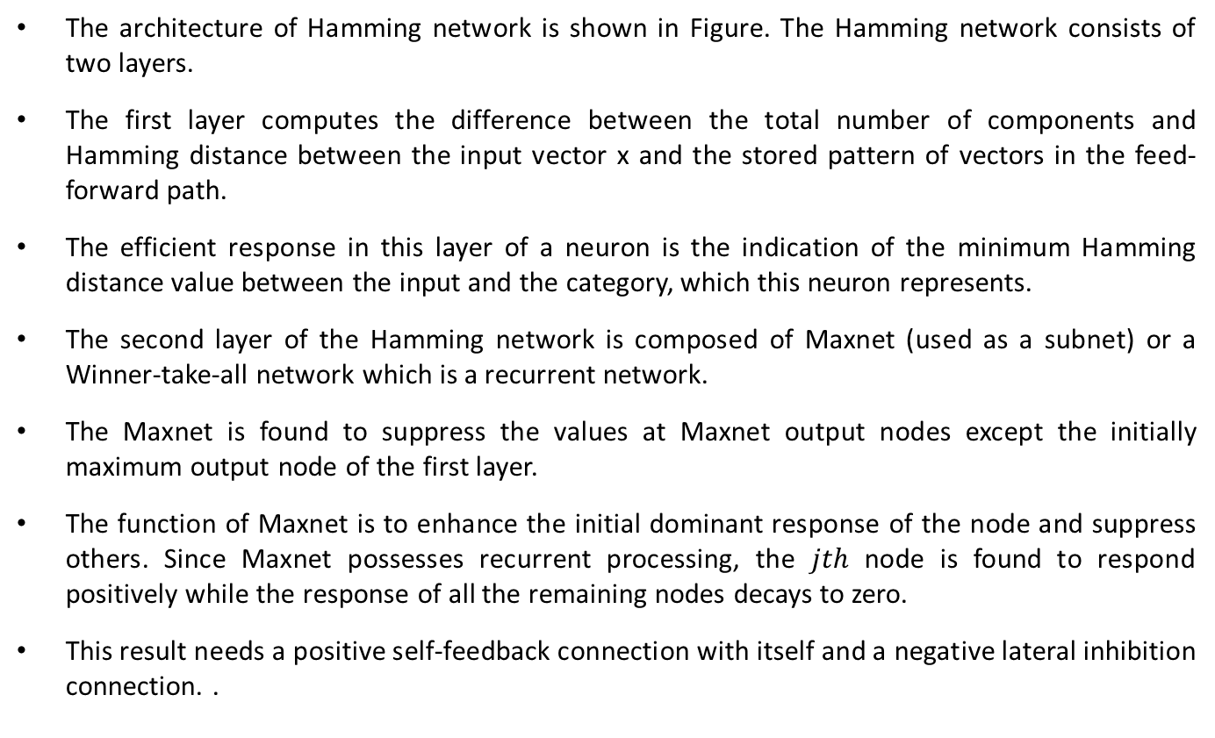
Hamming Network (Architecture)
The architecture of Hamming network is shown in Figure. The Hamming network consists of two layers.
The first layer computes the difference between the total number of components and Hamming distance between the input vector x and the stored pattern of vectors in the feed-forward path.
The efficient response in this layer of a neuron is the indication of the minimum Hamming distance value between the input and the category, which this neuron represents.
The second layer of the Hamming network is composed of Maxnet (used as a subnet) or a Winner-take-all network which is a recurrent network.
The Maxnet is found to suppress the values at Maxnet output nodes except the initially maximum output node of the first layer.
The function of Maxnet is to enhance the initial dominant response of the node and suppress others. Since Maxnet possesses recurrent processing, the $jth$ node is found to respond positively while the response of all the remaining nodes decays to zero.
This result needs a positive self-feedback connection with itself and a negative lateral inhibition connection. .

Slide 31
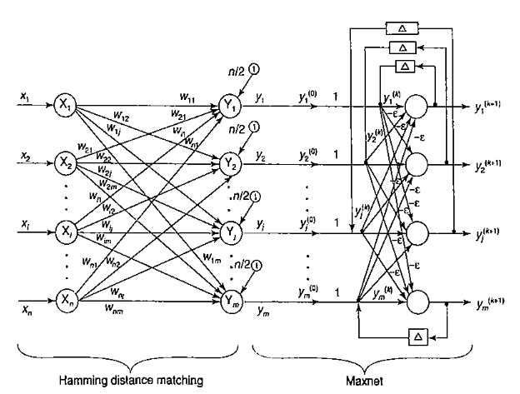
Hamming Network (Architecture)

Slide 32
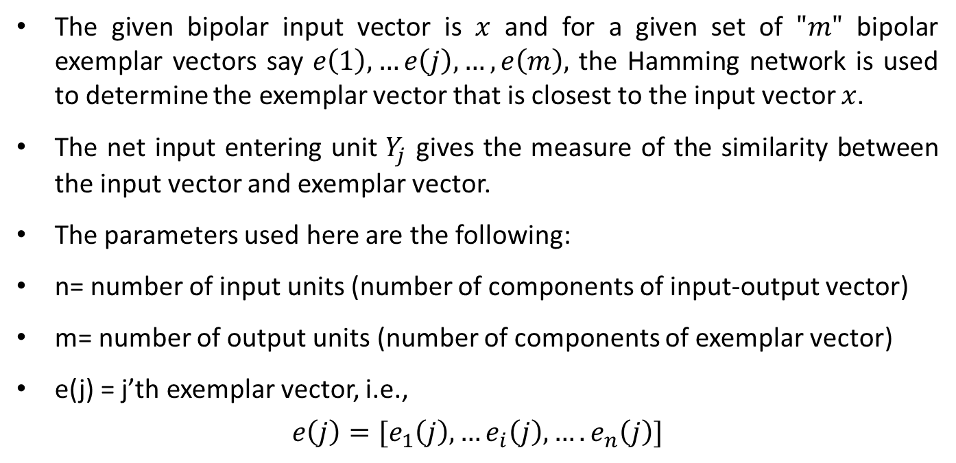
Hamming Network (Testing Algorithm)
The given bipolar input vector is $x$ and for a given set of $"m"$ bipolar exemplar vectors say $e\left(1\right),…e\left(j\right),…,e\left(m\right),$ the Hamming network is used to determine the exemplar vector that is closest to the input vector $x$.
The net input entering unit $Y_{j}$ gives the measure of the similarity between the input vector and exemplar vector.
The parameters used here are the following:
n= number of input units (number of components of input-output vector)
m= number of output units (number of components of exemplar vector)
e(j) = j’th exemplar vector, i.e.,
$$e\left(j\right)=[e_{1}\left(j\right),…e_{i}\left(j\right),….e_{n}\left(j\right)]$$

Slide 33
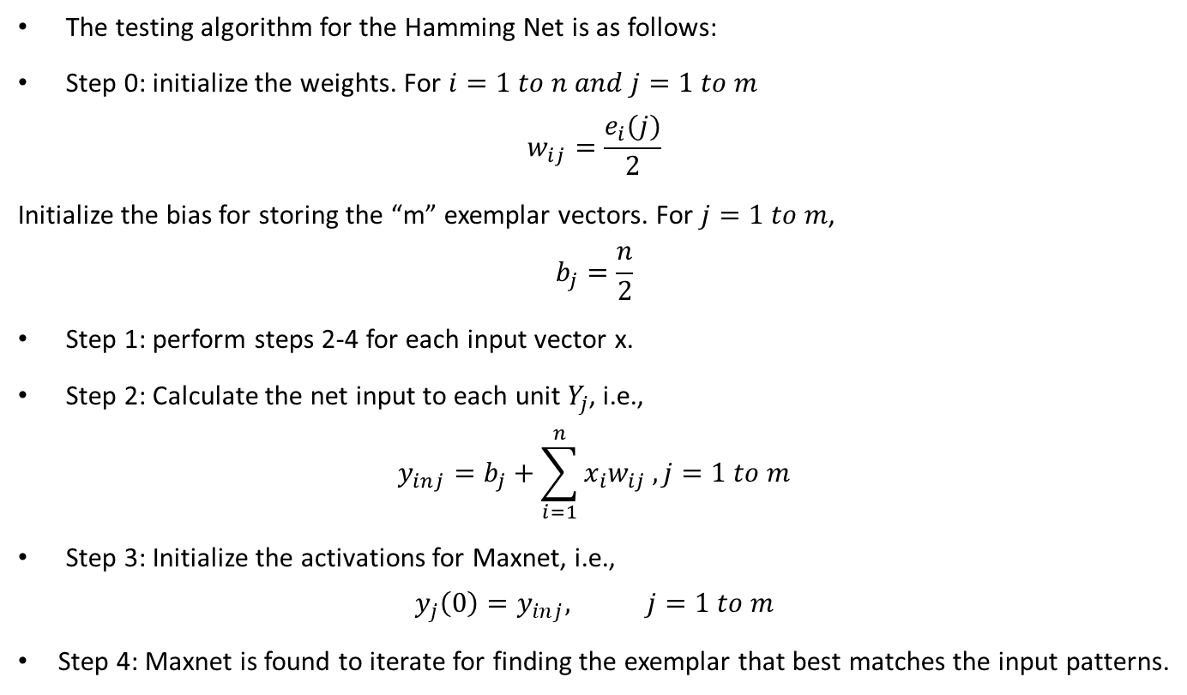
Hamming Network (Testing Algorithm)
The testing algorithm for the Hamming Net is as follows:
Step 0: initialize the weights. For $i=1 to n and j=1 to m$
$$w_{ij}=\frac{e_{i}(j)}{2}$$
Initialize the bias for storing the “m” exemplar vectors. For $j=1 to m$,
$$b_{j}=\frac{n}{2}$$
Step 1: perform steps 2-4 for each input vector x.
Step 2: Calculate the net input to each unit $Y_{j}$, i.e.,
$$y_{inj}=b_{j}+\sum_{i=1}^{n}{x_{i}w_{ij}}, j=1 to m$$
Step 3: Initialize the activations for Maxnet, i.e.,
$$y_{j}\left(0\right)=y_{inj}, j=1 to m$$
Step 4: Maxnet is found to iterate for finding the exemplar that best matches the input patterns.

Slide 34
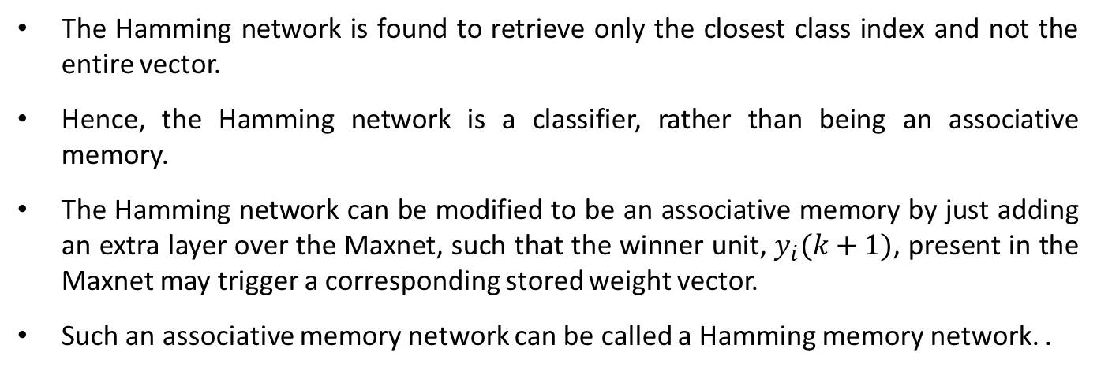
Hamming Network (Testing Algorithm)
The Hamming network is found to retrieve only the closest class index and not the entire vector.
Hence, the Hamming network is a classifier, rather than being an associative memory.
The Hamming network can be modified to be an associative memory by just adding an extra layer over the Maxnet, such that the winner unit, $y_{i}(k+1)$, present in the Maxnet may trigger a corresponding stored weight vector.
Such an associative memory network can be called a Hamming memory network. .

Slide 35
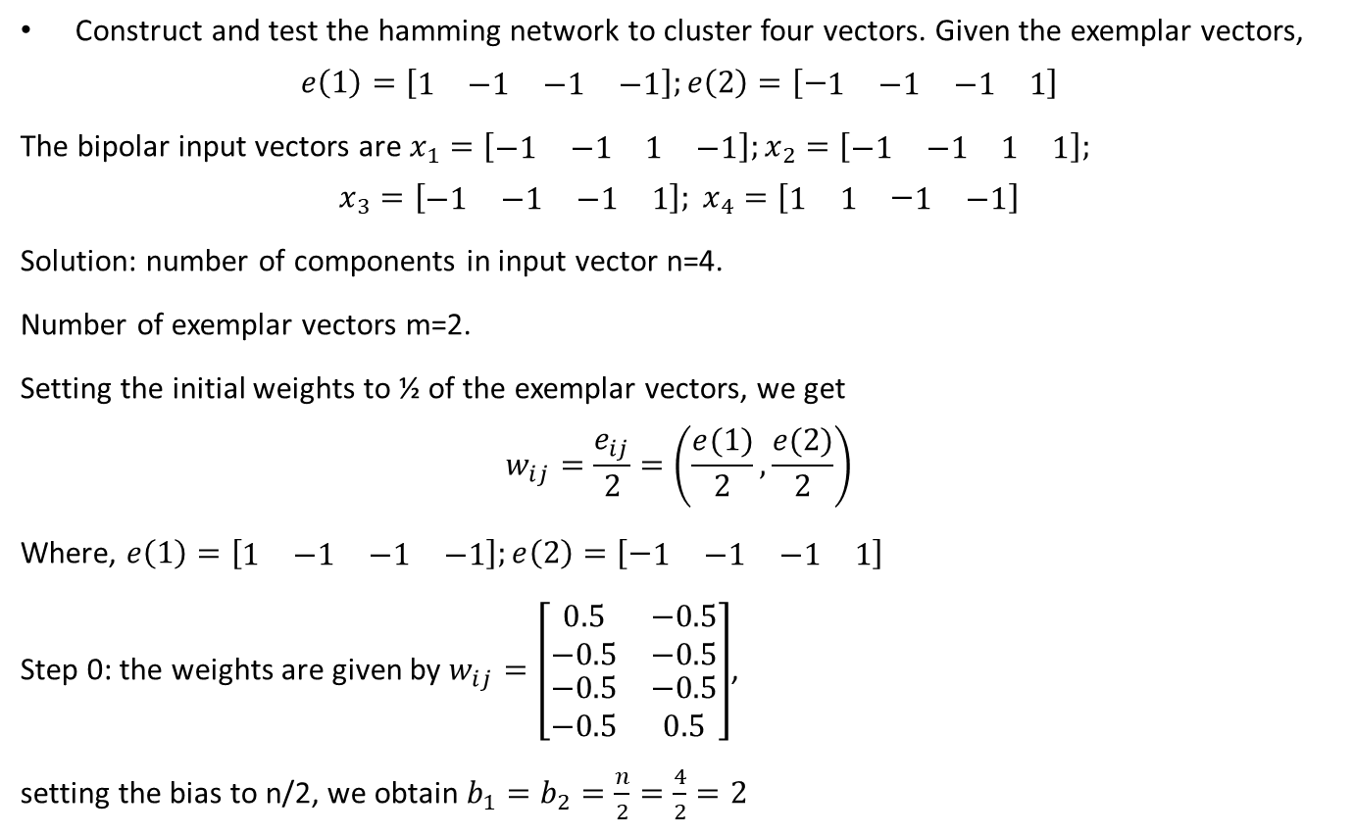
Hamming Network (Example)
Construct and test the hamming network to cluster four vectors. Given the exemplar vectors,
$$e\left(1\right)=\left[\begin{matrix}\begin{matrix}1 & −1\end{matrix} & \begin{matrix}−1 & −1\end{matrix}\end{matrix}\right];e\left(2\right)=\left[−\begin{matrix}\begin{matrix}1 & −1\end{matrix} & \begin{matrix}−1 & 1\end{matrix}\end{matrix}\right]$$
The bipolar input vectors are $x_{1}=\left[\begin{matrix}\begin{matrix}−1 & −1\end{matrix} & \begin{matrix}1 & −1\end{matrix}\end{matrix}\right];x_{2}=\left[\begin{matrix}\begin{matrix}−1 & −1\end{matrix} & \begin{matrix}1 & 1\end{matrix}\end{matrix}\right];$
$$x_{3}=\left[\begin{matrix}\begin{matrix}−1 & −1\end{matrix} & \begin{matrix}−1 & 1\end{matrix}\end{matrix}\right]; x_{4}=\left[\begin{matrix}\begin{matrix}1 & 1\end{matrix} & −\begin{matrix}1 & −1\end{matrix}\end{matrix}\right]$$
Solution: number of components in input vector n=4.
Number of exemplar vectors m=2.
Setting the initial weights to ½ of the exemplar vectors, we get
$$w_{ij}=\frac{e_{ij}}{2}=\left(\frac{e(1)}{2},\frac{e(2)}{2}\right)$$
Where, $e\left(1\right)=\left[\begin{matrix}\begin{matrix}1 & −1\end{matrix} & \begin{matrix}−1 & −1\end{matrix}\end{matrix}\right];e\left(2\right)=\left[−\begin{matrix}\begin{matrix}1 & −1\end{matrix} & \begin{matrix}−1 & 1\end{matrix}\end{matrix}\right]$
Step 0: the weights are given by $w_{ij}=\left[\begin{matrix}\begin{matrix}\begin{matrix}0.5 \\ −0.5\end{matrix} \\ \begin{matrix}−0.5 \\ −0.5\end{matrix}\end{matrix} & \begin{matrix}\begin{matrix}−0.5 \\ −0.5\end{matrix} \\ \begin{matrix}−0.5 \\ 0.5\end{matrix}\end{matrix}\end{matrix}\right]$,
setting the bias to n/2, we obtain $b_{1}=b_{2}=\frac{n}{2}=\frac{4}{2}=2$

Slide 36
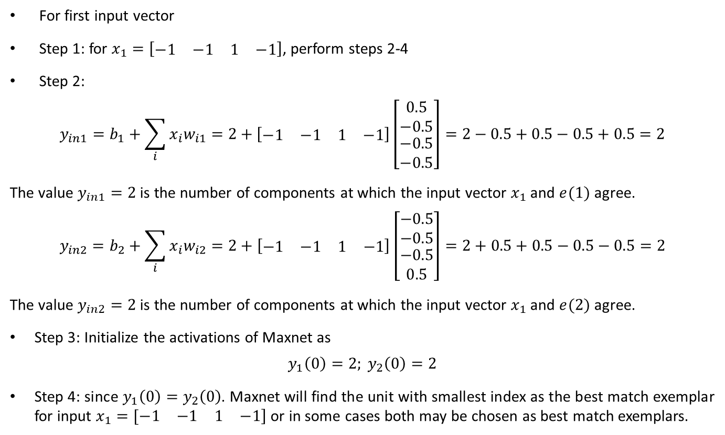
Hamming Network (Example)
For first input vector
Step 1: for $x_{1}=\left[\begin{matrix}\begin{matrix}−1 & −1\end{matrix} & \begin{matrix}1 & −1\end{matrix}\end{matrix}\right]$, perform steps 2-4
Step 2:
$$y_{in1}=b_{1}+\sum_{i}{x_{i}w_{i1}}=2+\left[\begin{matrix}\begin{matrix}−1 & −1\end{matrix} & \begin{matrix}1 & −1\end{matrix}\end{matrix}\right]\left[\begin{matrix}\begin{matrix}0.5 \\ −0.5\end{matrix} \\ \begin{matrix}−0.5 \\ −0.5\end{matrix}\end{matrix}\right]=2−0.5+0.5−0.5+0.5=2$$
The value $y_{in1}=2$ is the number of components at which the input vector $x_{1}$ and $e(1)$ agree.
$$y_{in2}=b_{2}+\sum_{i}{x_{i}w_{i2}}=2+\left[\begin{matrix}\begin{matrix}−1 & −1\end{matrix} & \begin{matrix}1 & −1\end{matrix}\end{matrix}\right]\left[\begin{matrix}\begin{matrix}−0.5 \\ −0.5\end{matrix} \\ \begin{matrix}−0.5 \\ 0.5\end{matrix}\end{matrix}\right]=2+0.5+0.5−0.5−0.5=2$$
The value $y_{in2}=2$ is the number of components at which the input vector $x_{1}$ and $e(2)$ agree.
Step 3: Initialize the activations of Maxnet as
$$y_{1}\left(0\right)=2; y_{2}\left(0\right)=2$$
Step 4: since $y_{1}\left(0\right)=y_{2}\left(0\right)$. Maxnet will find the unit with smallest index as the best match exemplar for input $x_{1}=[\begin{matrix}\begin{matrix}−1 & −1\end{matrix} & \begin{matrix}1 & −1\end{matrix}]\end{matrix}$ or in some cases both may be chosen as best match exemplars.

Slide 37
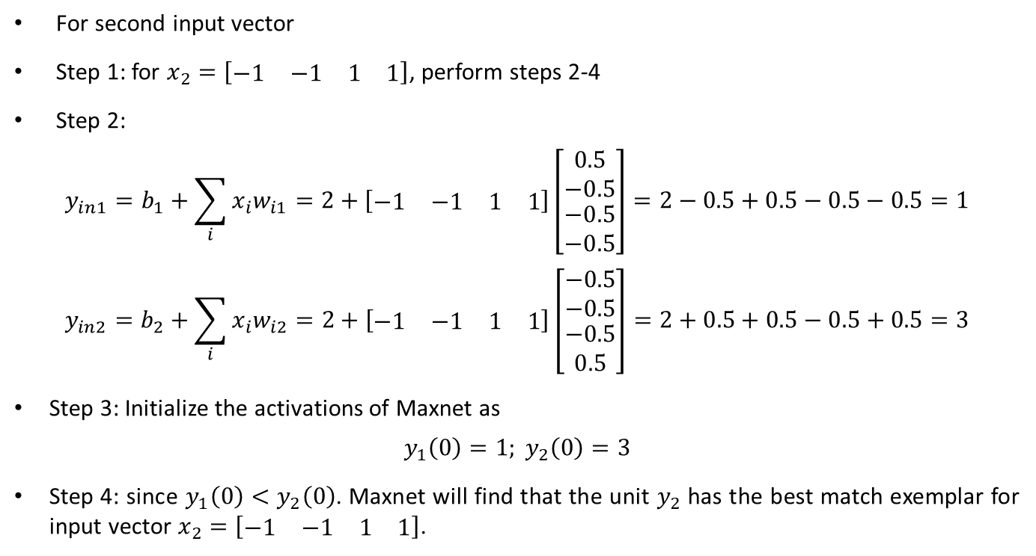
Hamming Network (Example)
For second input vector
Step 1: for $x_{2}=\left[\begin{matrix}\begin{matrix}−1 & −1\end{matrix} & \begin{matrix}1 & 1\end{matrix}\end{matrix}\right]$, perform steps 2-4
Step 2:
$$y_{in1}=b_{1}+\sum_{i}{x_{i}w_{i1}}=2+\left[\begin{matrix}\begin{matrix}−1 & −1\end{matrix} & \begin{matrix}1 & 1\end{matrix}\end{matrix}\right]\left[\begin{matrix}\begin{matrix}0.5 \\ −0.5\end{matrix} \\ \begin{matrix}−0.5 \\ −0.5\end{matrix}\end{matrix}\right]=2−0.5+0.5−0.5−0.5=1$$
$$y_{in2}=b_{2}+\sum_{i}{x_{i}w_{i2}}=2+\left[\begin{matrix}\begin{matrix}−1 & −1\end{matrix} & \begin{matrix}1 & 1\end{matrix}\end{matrix}\right]\left[\begin{matrix}\begin{matrix}−0.5 \\ −0.5\end{matrix} \\ \begin{matrix}−0.5 \\ 0.5\end{matrix}\end{matrix}\right]=2+0.5+0.5−0.5+0.5=3$$
Step 3: Initialize the activations of Maxnet as
$$y_{1}\left(0\right)=1; y_{2}\left(0\right)=3$$
Step 4: since $y_{1}\left(0\right)<y_{2}\left(0\right)$. Maxnet will find that the unit $y_{2}$ has the best match exemplar for input vector $x_{2}=\left[\begin{matrix}\begin{matrix}−1 & −1\end{matrix} & \begin{matrix}1 & 1\end{matrix}\end{matrix}\right]$.

Slide 38
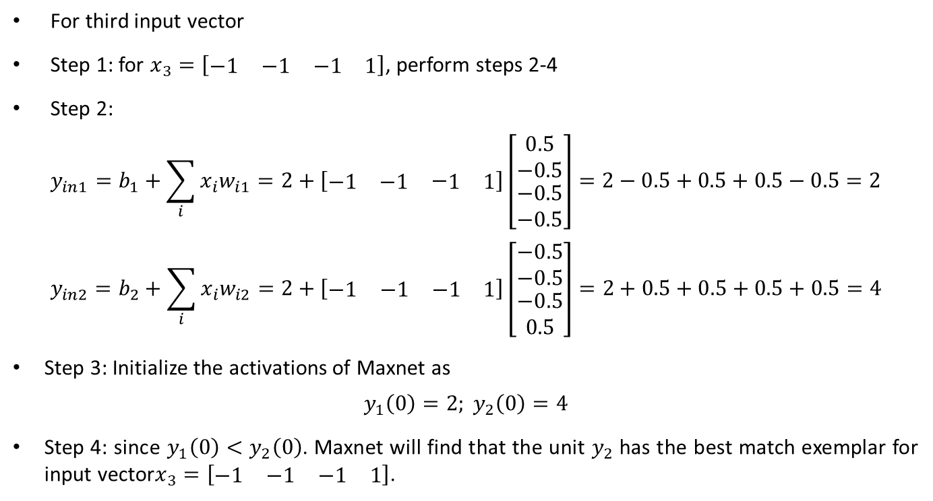
Hamming Network (Example)
For third input vector
Step 1: for $x_{3}=\left[\begin{matrix}\begin{matrix}−1 & −1\end{matrix} & \begin{matrix}−1 & 1\end{matrix}\end{matrix}\right]$, perform steps 2-4
Step 2:
$$y_{in1}=b_{1}+\sum_{i}{x_{i}w_{i1}}=2+\left[\begin{matrix}\begin{matrix}−1 & −1\end{matrix} & −\begin{matrix}1 & 1\end{matrix}\end{matrix}\right]\left[\begin{matrix}\begin{matrix}0.5 \\ −0.5\end{matrix} \\ \begin{matrix}−0.5 \\ −0.5\end{matrix}\end{matrix}\right]=2−0.5+0.5+0.5−0.5=2$$
$$y_{in2}=b_{2}+\sum_{i}{x_{i}w_{i2}}=2+\left[\begin{matrix}\begin{matrix}−1 & −1\end{matrix} & \begin{matrix}−1 & 1\end{matrix}\end{matrix}\right]\left[\begin{matrix}\begin{matrix}−0.5 \\ −0.5\end{matrix} \\ \begin{matrix}−0.5 \\ 0.5\end{matrix}\end{matrix}\right]=2+0.5+0.5+0.5+0.5=4$$
Step 3: Initialize the activations of Maxnet as
$$y_{1}\left(0\right)=2; y_{2}\left(0\right)=4$$
Step 4: since $y_{1}\left(0\right)<y_{2}\left(0\right)$. Maxnet will find that the unit $y_{2}$ has the best match exemplar for input vector$x_{3}=\left[\begin{matrix}\begin{matrix}−1 & −1\end{matrix} & \begin{matrix}−1 & 1\end{matrix}\end{matrix}\right]$.

Slide 39
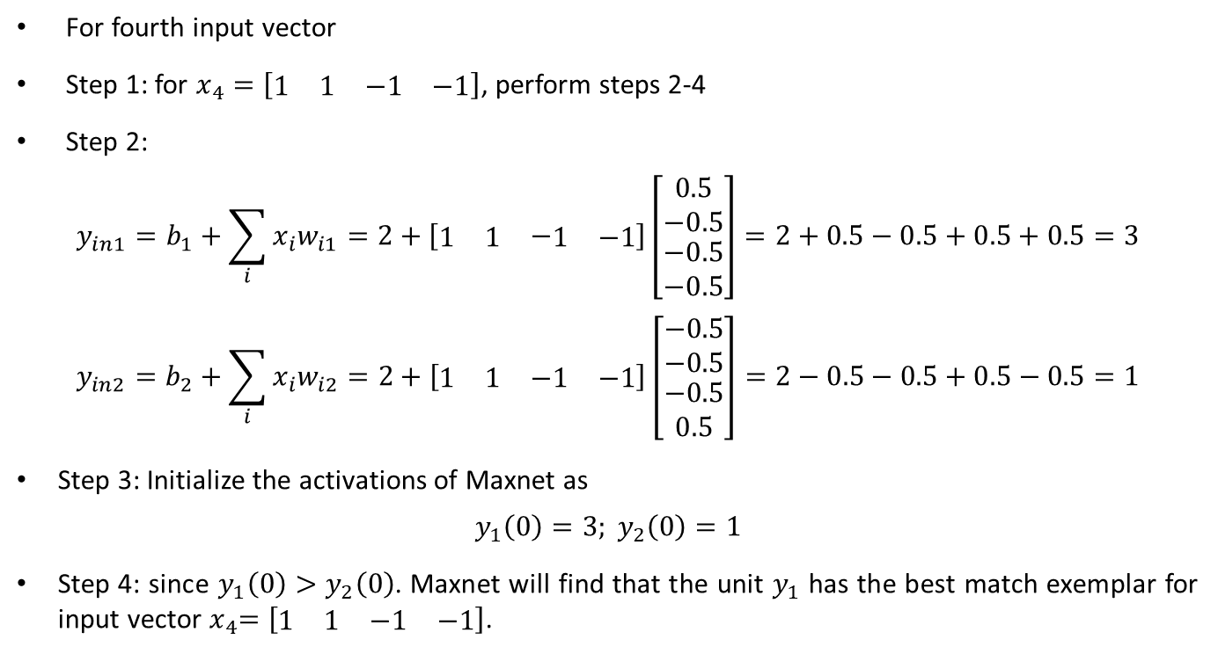
Hamming Network (Example)
For fourth input vector
Step 1: for $x_{4}=\left[\begin{matrix}\begin{matrix}1 & 1\end{matrix} & \begin{matrix}−1 & −1\end{matrix}\end{matrix}\right]$, perform steps 2-4
Step 2:
$$y_{in1}=b_{1}+\sum_{i}{x_{i}w_{i1}}=2+\left[\begin{matrix}\begin{matrix}1 & 1\end{matrix} & −\begin{matrix}1 & −1\end{matrix}\end{matrix}\right]\left[\begin{matrix}\begin{matrix}0.5 \\ −0.5\end{matrix} \\ \begin{matrix}−0.5 \\ −0.5\end{matrix}\end{matrix}\right]=2+0.5−0.5+0.5+0.5=3$$
$$y_{in2}=b_{2}+\sum_{i}{x_{i}w_{i2}}=2+\left[\begin{matrix}\begin{matrix}1 & 1\end{matrix} & \begin{matrix}−1 & −1\end{matrix}\end{matrix}\right]\left[\begin{matrix}\begin{matrix}−0.5 \\ −0.5\end{matrix} \\ \begin{matrix}−0.5 \\ 0.5\end{matrix}\end{matrix}\right]=2−0.5−0.5+0.5−0.5=1$$
Step 3: Initialize the activations of Maxnet as
$$y_{1}\left(0\right)=3; y_{2}\left(0\right)=1$$
Step 4: since $y_{1}\left(0\right)>y_{2}\left(0\right)$. Maxnet will find that the unit $y_{1}$ has the best match exemplar for input vector${ x}_{4}=\left[\begin{matrix}\begin{matrix}1 & 1\end{matrix} & \begin{matrix}−1 & −1\end{matrix}\end{matrix}\right]$.

Slide 40
Kohonen Self-Organizing Feature Maps
Feature mapping is a process which converts the patterns of arbitrary dimensionality into a response of one or two dimensional arrays of neurons i.e., it converts a wide pattern space into a typical feature space.
The network performing such a mapping is called feature map.
Apart from its capability to reduce the higher dimensionality, it has to preserve the neighborhood relations of the input patterns, i.e., it has to obtain a topology preserving map.
For obtaining such feature maps, it is required to find a self-organizing neural array which consists of neurons arranged in one-dimensional array or a two-dimensional array.
To depict this, a typical network structure where each component of the input vector x is connected to each of the nodes is shown in figure.

Slide 43
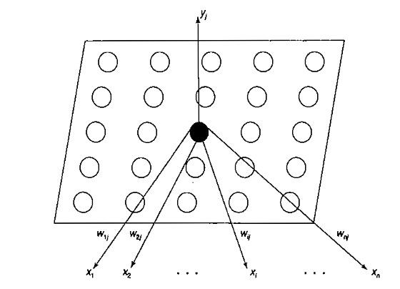

Slide 44
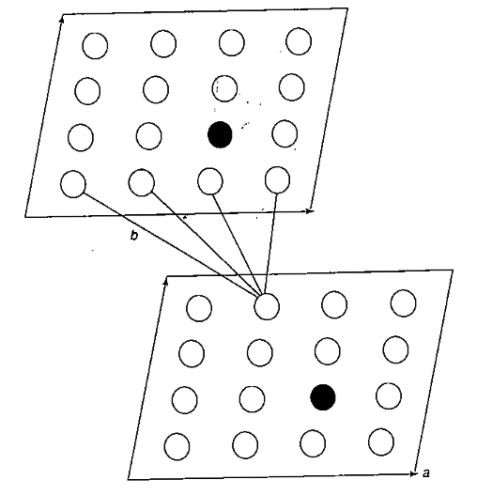
Kohonen Self-Organizing Feature Maps
On the other hand, if the input vector is two-dimensional, the inputs, say x(a, b), can arrange themselves in a two-dimensional array defining the input space (a, b) as in Figure. Here, the two layers are fully connected,

Slide 45
Kohonen Self-Organizing Feature Maps
The topological preserving property is observed in the brain, but not found in any other artificial neural network.
Here, there are m output cluster units arranged in a one- or two-dimensional array and the input signals are n-tuples.
The cluster (output) units weight vector serves as an exemplar of the input pattern that is associated with that cluster.
At the time of self-organization, the weight vector of the cluster unit which matches the input pattern very closely is chosen as the winner unit.
The closeness of weight vector of cluster unit to the input pattern may be based on the square of the minimum Euclidean distance.
The weights are updated for the winning unit and its neighboring units. It should be noted that the weight vectors of the neighboring units are not close to the input pattern and the connective weights do not multiply the signal sent from the input units to the cluster units until dot product measure of similarity is being used.

Slide 46
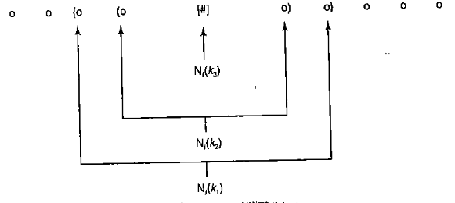
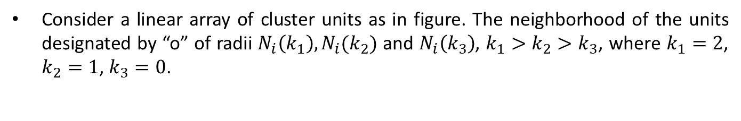
Architecture
Consider a linear array of cluster units as in figure. The neighborhood of the units designated by “o” of radii $N_{i}\left(k_{1}\right), N_{i}(k_{2})$ and $N_{i}\left(k_{3}\right)$, $k_{1}>k_{2}>k_{3}$, where $k_{1}=2$, $k_{2}=1$, $k_{3}=0$.

Slide 47
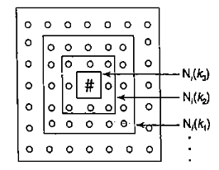
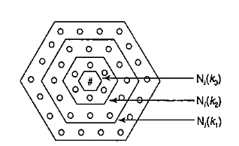
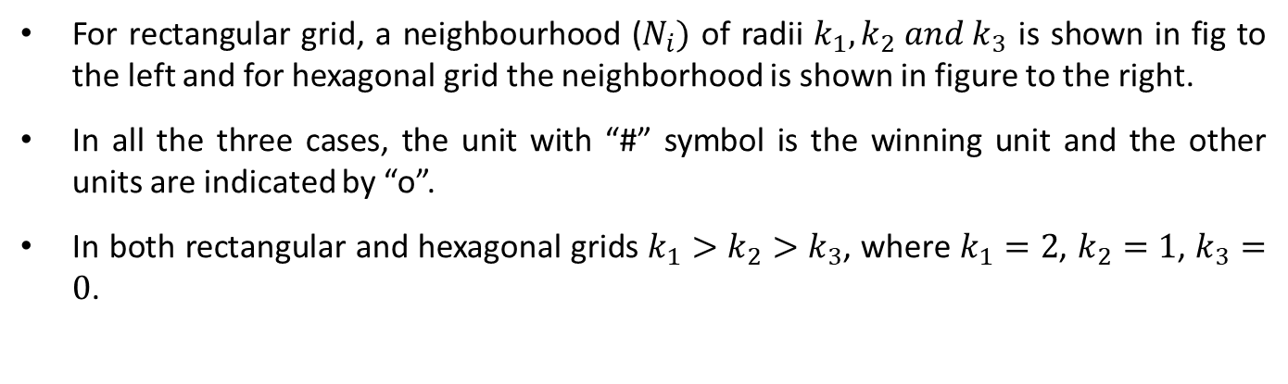
Architecture
For rectangular grid, a neighbourhood ($N_{i})$ of radii $k_{1}, k_{2} and k_{3}$ is shown in fig to the left and for hexagonal grid the neighborhood is shown in figure to the right.
In all the three cases, the unit with “#” symbol is the winning unit and the other units are indicated by “o”.
In both rectangular and hexagonal grids $k_{1}>k_{2}>k_{3}$, where $k_{1}=2$, $k_{2}=1$, $k_{3}=0$.

Slide 48
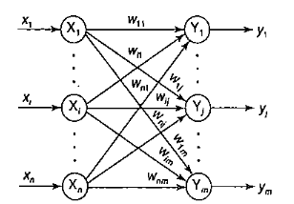
Architecture
For rectangular grid, each unit has eight nearest neighbours but there are only six neighbours for each unit in the case of hexagonal grid.
Missing neighbourhood may just be ignored. A typical architecture of Kohonen self-organizing feature map (KSOFM) is shown in figure.

Slide 49
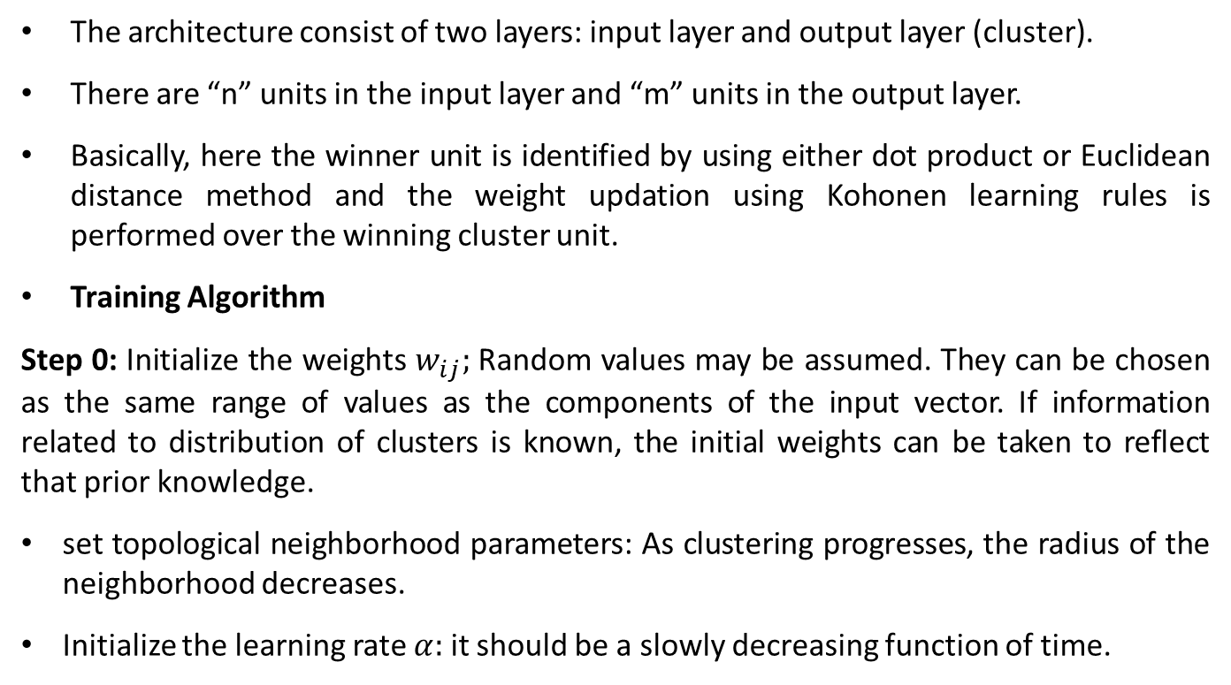
Training Algorithm
The architecture consist of two layers: input layer and output layer (cluster).
There are “n” units in the input layer and “m” units in the output layer.
Basically, here the winner unit is identified by using either dot product or Euclidean distance method and the weight updation using Kohonen learning rules is performed over the winning cluster unit.
Training Algorithm
Step 0: Initialize the weights $w_{ij};$ Random values may be assumed. They can be chosen as the same range of values as the components of the input vector. If information related to distribution of clusters is known, the initial weights can be taken to reflect that prior knowledge.
set topological neighborhood parameters: As clustering progresses, the radius of the neighborhood decreases.
Initialize the learning rate $α:$ it should be a slowly decreasing function of time.

Slide 50
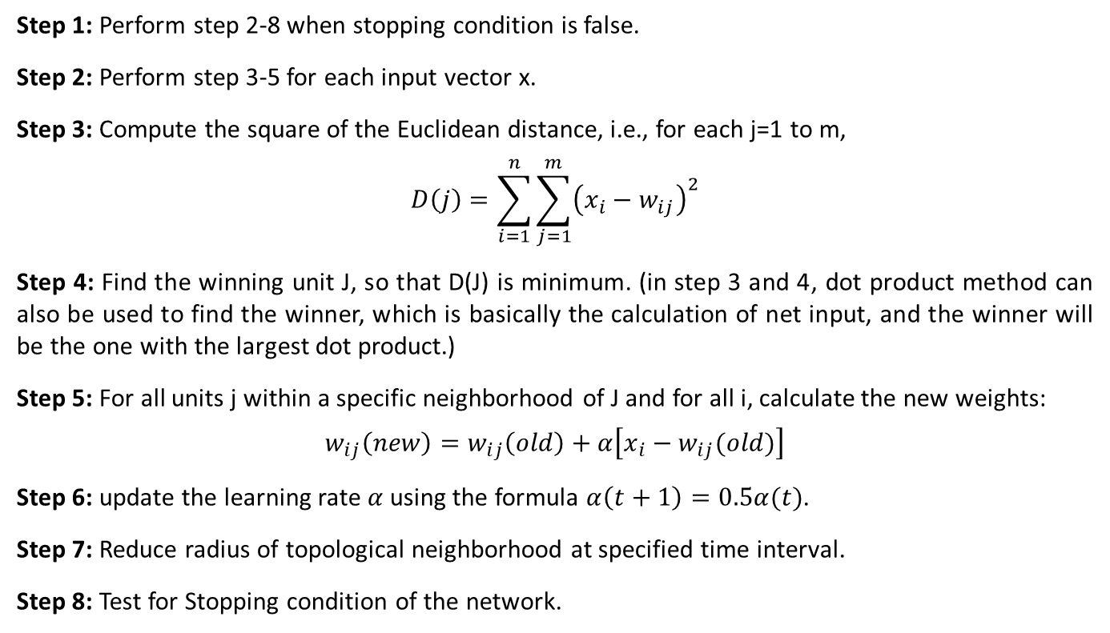
Training Algorithm
Step 1: Perform step 2-8 when stopping condition is false.
Step 2: Perform step 3-5 for each input vector x.
Step 3: Compute the square of the Euclidean distance, i.e., for each j=1 to m,
$$D\left(j\right)=\sum_{i=1}^{n}{\sum_{j=1}^{m}{{\left(x_{i}−w_{ij}\right)}^{2}}}$$
Step 4: Find the winning unit J, so that D(J) is minimum. (in step 3 and 4, dot product method can also be used to find the winner, which is basically the calculation of net input, and the winner will be the one with the largest dot product.)
Step 5: For all units j within a specific neighborhood of J and for all i, calculate the new weights:
$$w_{ij}\left(new\right)=w_{ij}\left(old\right)+α\left[x_{i}−w_{ij}(old)\right]$$
Step 6: update the learning rate $α$using the formula $α\left(t+1\right)=0.5α(t)$.
Step 7: Reduce radius of topological neighborhood at specified time interval.
Step 8: Test for Stopping condition of the network.

Slide 53
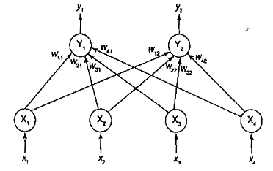
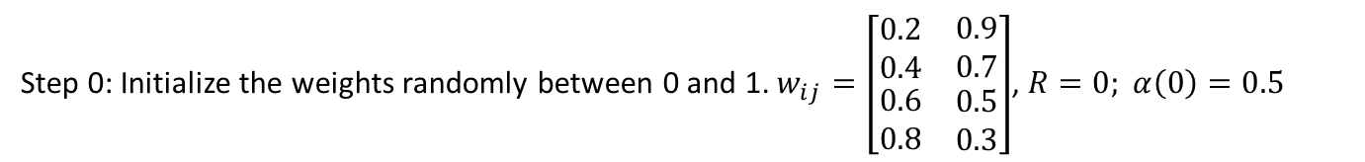
KSOFM (Example)
Construct a self-organizing map to cluster the four given vectors, [0 0 1 1], [1 0 0 0], [0 1 1 0] and [0 0 0 1]. The number of clusters to be formed is two. Assume an initial learning rate of 0.5.
Solution:
The number of input vectors is four and number of clusters to be formed is two. Thus, n=4 and m=2. The architecture of Kohonen self-organizing feature map is given by figure.
Step 0: Initialize the weights randomly between 0 and 1. $w_{ij}=\left[\begin{matrix}\begin{matrix}\begin{matrix}0.2 \\ 0.4\end{matrix} \\ \begin{matrix}0.6 \\ 0.8\end{matrix}\end{matrix} & \begin{matrix}\begin{matrix}0.9 \\ 0.7\end{matrix} \\ \begin{matrix}0.5 \\ 0.3\end{matrix}\end{matrix}\end{matrix}\right]$, $R=0; α\left(0\right)=0.5$

Slide 54
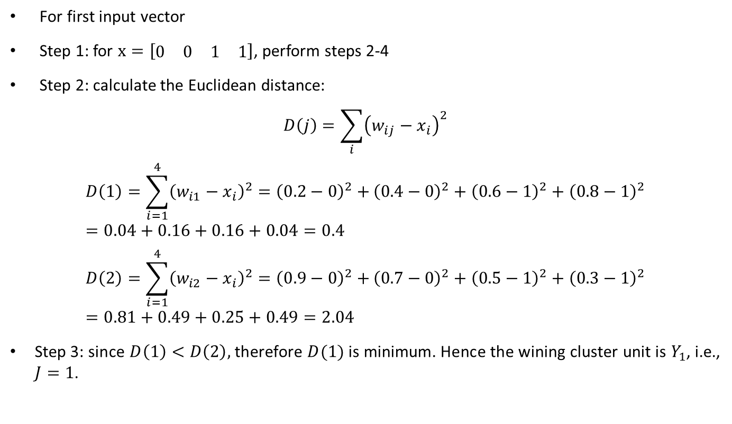
KSOFM (Example)
For first input vector
Step 1: for $x=\left[\begin{matrix}\begin{matrix}0 & 0\end{matrix} & \begin{matrix}1 & 1\end{matrix}\end{matrix}\right]$, perform steps 2-4
Step 2: calculate the Euclidean distance:
$$D\left(j\right)=\sum_{i}{{\left(w_{ij}−x_{i}\right)}^{2}}$$
$$D\left(1\right)=\sum_{i=1}^{4}{{\left(w_{i1}−x_{i}\right)}^{2}={\left(0.2−0\right)}^{2}+}{\left(0.4−0\right)}^{2}+{\left(0.6−1\right)}^{2}+{\left(0.8−1\right)}^{2}=0.04+0.16+0.16+0.04=0.4$$
$$D\left(2\right)=\sum_{i=1}^{4}{{\left(w_{i2}−x_{i}\right)}^{2}={\left(0.9−0\right)}^{2}+}{\left(0.7−0\right)}^{2}+{\left(0.5−1\right)}^{2}+{\left(0.3−1\right)}^{2}=0.81+0.49+0.25+0.49=2.04$$
Step 3: since $D\left(1\right)<D\left(2\right),$ therefore $D(1)$ is minimum. Hence the wining cluster unit is $Y_{1}$, i.e., $J=1$.

Slide 55
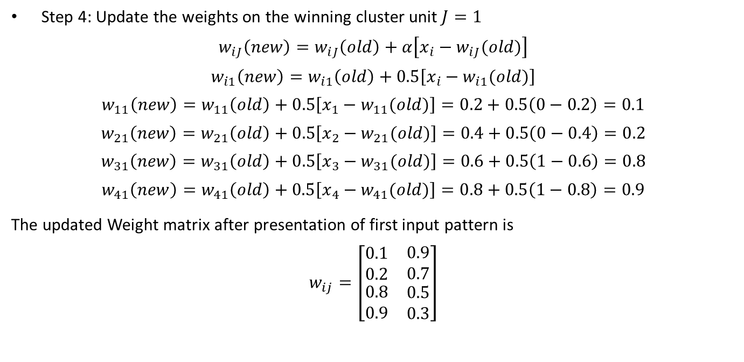
KSOFM (Example)
Step 4: Update the weights on the winning cluster unit $J=1$
$$w_{iJ}\left(new\right)=w_{iJ}\left(old\right)+α\left[x_{i}−w_{iJ}(old)\right]$$
$$w_{i1}\left(new\right)=w_{i1}\left(old\right)+0.5\left[x_{i}−w_{i1}(old)\right]$$
$$w_{11}\left(new\right)=w_{11}\left(old\right)+0.5\left[x_{1}−w_{11}(old)\right]=0.2+0.5\left(0−0.2\right)=0.1$$
$$w_{21}\left(new\right)=w_{21}\left(old\right)+0.5\left[x_{2}−w_{21}(old)\right]=0.4+0.5\left(0−0.4\right)=0.2$$
$$w_{31}\left(new\right)=w_{31}\left(old\right)+0.5\left[x_{3}−w_{31}(old)\right]=0.6+0.5\left(1−0.6\right)=0.8$$
$$w_{41}\left(new\right)=w_{41}\left(old\right)+0.5\left[x_{4}−w_{41}(old)\right]=0.8+0.5\left(1−0.8\right)=0.9$$
The updated Weight matrix after presentation of first input pattern is
$$w_{ij}=\left[\begin{matrix}\begin{matrix}\begin{matrix}0.1 \\ 0.2\end{matrix} \\ \begin{matrix}0.8 \\ 0.9\end{matrix}\end{matrix} & \begin{matrix}\begin{matrix}0.9 \\ 0.7\end{matrix} \\ \begin{matrix}0.5 \\ 0.3\end{matrix}\end{matrix}\end{matrix}\right]$$

Slide 56
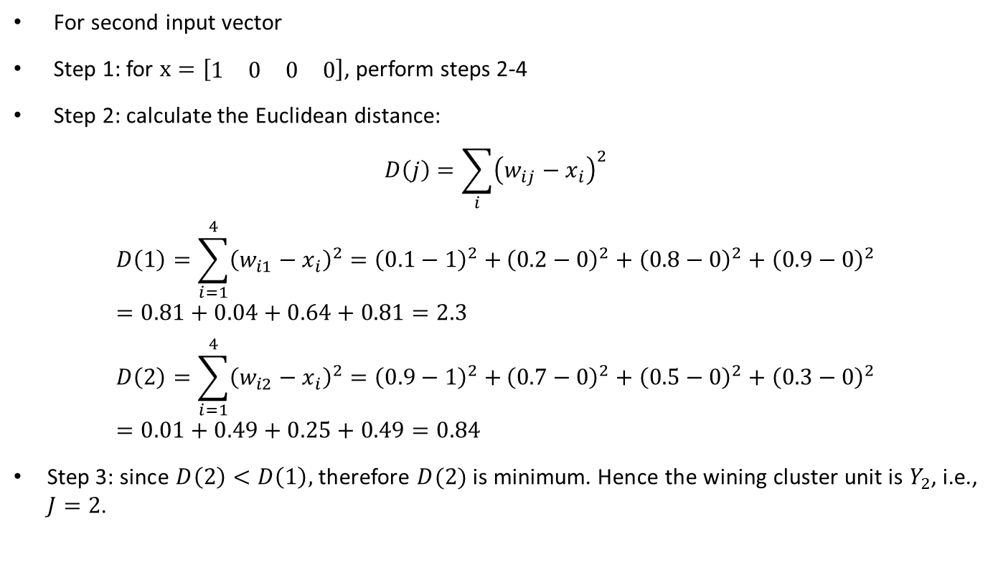
KSOFM (Example)
For second input vector
Step 1: for $x=\left[\begin{matrix}\begin{matrix}1 & 0\end{matrix} & \begin{matrix}0 & 0\end{matrix}\end{matrix}\right]$, perform steps 2-4
Step 2: calculate the Euclidean distance:
$$D\left(j\right)=\sum_{i}{{\left(w_{ij}−x_{i}\right)}^{2}}$$
$$D\left(1\right)=\sum_{i=1}^{4}{{\left(w_{i1}−x_{i}\right)}^{2}={\left(0.1−1\right)}^{2}+}{\left(0.2−0\right)}^{2}+{\left(0.8−0\right)}^{2}+{\left(0.9−0\right)}^{2}=0.81+0.04+0.64+0.81=2.3$$
$$D\left(2\right)=\sum_{i=1}^{4}{{\left(w_{i2}−x_{i}\right)}^{2}={\left(0.9−1\right)}^{2}+}{\left(0.7−0\right)}^{2}+{\left(0.5−0\right)}^{2}+{\left(0.3−0\right)}^{2}=0.01+0.49+0.25+0.49=0.84$$
Step 3: since $D\left(2\right)<D\left(1\right),$ therefore $D(2)$ is minimum. Hence the wining cluster unit is $Y_{2}$, i.e., $J=2$.

Slide 57
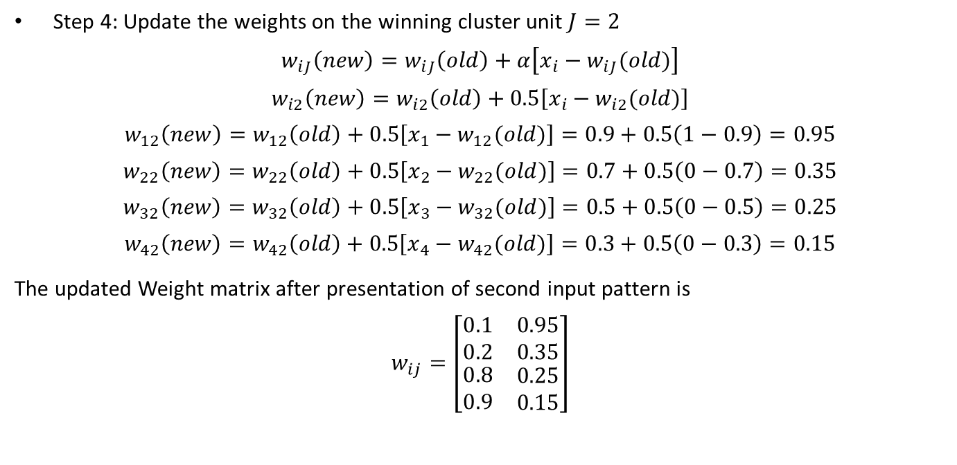
KSOFM (Example)
Step 4: Update the weights on the winning cluster unit $J=2$
$$w_{iJ}\left(new\right)=w_{iJ}\left(old\right)+α\left[x_{i}−w_{iJ}(old)\right]$$
$$w_{i2}\left(new\right)=w_{i2}\left(old\right)+0.5\left[x_{i}−w_{i2}(old)\right]$$
$$w_{12}\left(new\right)=w_{12}\left(old\right)+0.5\left[x_{1}−w_{12}(old)\right]=0.9+0.5\left(1−0.9\right)=0.95$$
$$w_{22}\left(new\right)=w_{22}\left(old\right)+0.5\left[x_{2}−w_{22}(old)\right]=0.7+0.5\left(0−0.7\right)=0.35$$
$$w_{32}\left(new\right)=w_{32}\left(old\right)+0.5\left[x_{3}−w_{32}(old)\right]=0.5+0.5\left(0−0.5\right)=0.25$$
$$w_{42}\left(new\right)=w_{42}\left(old\right)+0.5\left[x_{4}−w_{42}(old)\right]=0.3+0.5\left(0−0.3\right)=0.15$$
The updated Weight matrix after presentation of second input pattern is
$$w_{ij}=\left[\begin{matrix}\begin{matrix}\begin{matrix}0.1 \\ 0.2\end{matrix} \\ \begin{matrix}0.8 \\ 0.9\end{matrix}\end{matrix} & \begin{matrix}\begin{matrix}0.95 \\ 0.35\end{matrix} \\ \begin{matrix}0.25 \\ 0.15\end{matrix}\end{matrix}\end{matrix}\right]$$

Slide 58
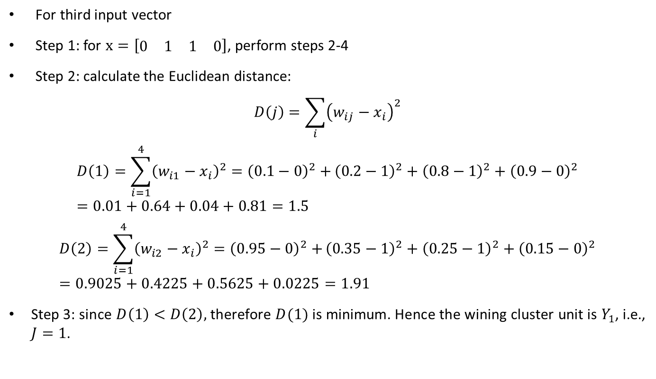
KSOFM (Example)
For third input vector
Step 1: for $x=\left[\begin{matrix}\begin{matrix}0 & 1\end{matrix} & \begin{matrix}1 & 0\end{matrix}\end{matrix}\right]$, perform steps 2-4
Step 2: calculate the Euclidean distance:
$$D\left(j\right)=\sum_{i}{{\left(w_{ij}−x_{i}\right)}^{2}}$$
$$D\left(1\right)=\sum_{i=1}^{4}{{\left(w_{i1}−x_{i}\right)}^{2}={\left(0.1−0\right)}^{2}+}{\left(0.2−1\right)}^{2}+{\left(0.8−1\right)}^{2}+{\left(0.9−0\right)}^{2}=0.01+0.64+0.04+0.81=1.5$$
$$D\left(2\right)=\sum_{i=1}^{4}{{\left(w_{i2}−x_{i}\right)}^{2}={\left(0.95−0\right)}^{2}+}{\left(0.35−1\right)}^{2}+{\left(0.25−1\right)}^{2}+{\left(0.15−0\right)}^{2}=0.9025+0.4225+0.5625+0.0225=1.91$$
Step 3: since $D\left(1\right)<D\left(2\right),$ therefore $D(1)$ is minimum. Hence the wining cluster unit is $Y_{1}$, i.e., $J=1$.

Slide 59
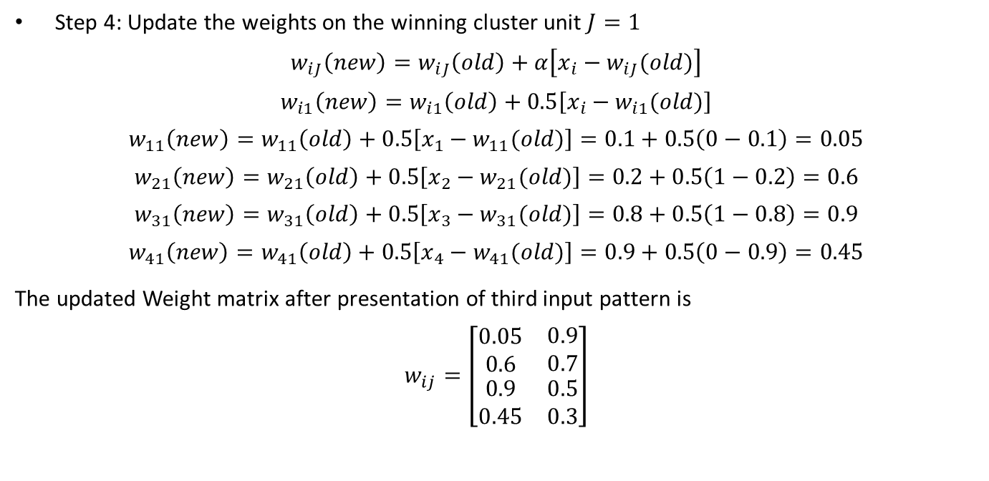
KSOFM (Example)
Step 4: Update the weights on the winning cluster unit $J=1$
$$w_{iJ}\left(new\right)=w_{iJ}\left(old\right)+α\left[x_{i}−w_{iJ}(old)\right]$$
$$w_{i1}\left(new\right)=w_{i1}\left(old\right)+0.5\left[x_{i}−w_{i1}(old)\right]$$
$$w_{11}\left(new\right)=w_{11}\left(old\right)+0.5\left[x_{1}−w_{11}(old)\right]=0.1+0.5\left(0−0.1\right)=0.05$$
$$w_{21}\left(new\right)=w_{21}\left(old\right)+0.5\left[x_{2}−w_{21}(old)\right]=0.2+0.5\left(1−0.2\right)=0.6$$
$$w_{31}\left(new\right)=w_{31}\left(old\right)+0.5\left[x_{3}−w_{31}(old)\right]=0.8+0.5\left(1−0.8\right)=0.9$$
$$w_{41}\left(new\right)=w_{41}\left(old\right)+0.5\left[x_{4}−w_{41}(old)\right]=0.9+0.5\left(0−0.9\right)=0.45$$
The updated Weight matrix after presentation of third input pattern is
$$w_{ij}=\left[\begin{matrix}\begin{matrix}\begin{matrix}0.05 \\ 0.6\end{matrix} \\ \begin{matrix}0.9 \\ 0.45\end{matrix}\end{matrix} & \begin{matrix}\begin{matrix}0.9 \\ 0.7\end{matrix} \\ \begin{matrix}0.5 \\ 0.3\end{matrix}\end{matrix}\end{matrix}\right]$$

Slide 60
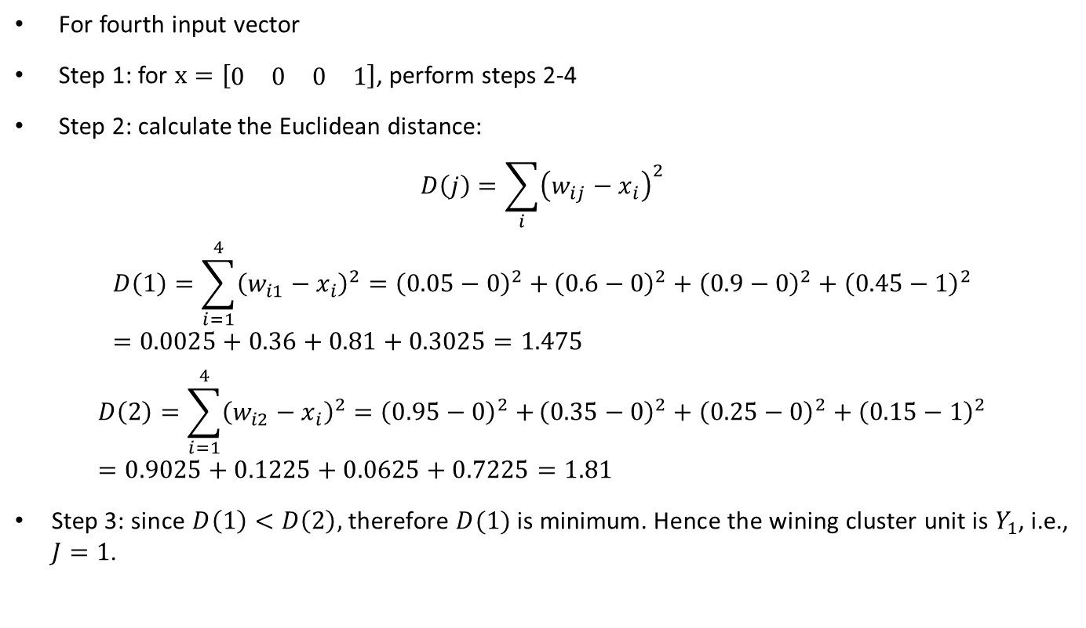
KSOFM (Example)
For fourth input vector
Step 1: for $x=\left[\begin{matrix}\begin{matrix}0 & 0\end{matrix} & \begin{matrix}0 & 1\end{matrix}\end{matrix}\right]$, perform steps 2-4
Step 2: calculate the Euclidean distance:
$$D\left(j\right)=\sum_{i}{{\left(w_{ij}−x_{i}\right)}^{2}}$$
$$D\left(1\right)=\sum_{i=1}^{4}{{\left(w_{i1}−x_{i}\right)}^{2}={\left(0.05−0\right)}^{2}+}{\left(0.6−0\right)}^{2}+{\left(0.9−0\right)}^{2}+{\left(0.45−1\right)}^{2}=0.0025+0.36+0.81+0.3025=1.475$$
$$D\left(2\right)=\sum_{i=1}^{4}{{\left(w_{i2}−x_{i}\right)}^{2}={\left(0.95−0\right)}^{2}+}{\left(0.35−0\right)}^{2}+{\left(0.25−0\right)}^{2}+{\left(0.15−1\right)}^{2}=0.9025+0.1225+0.0625+0.7225=1.81$$
Step 3: since $D\left(1\right)<D\left(2\right),$ therefore $D(1)$ is minimum. Hence the wining cluster unit is $Y_{1}$, i.e., $J=1$.

Slide 61
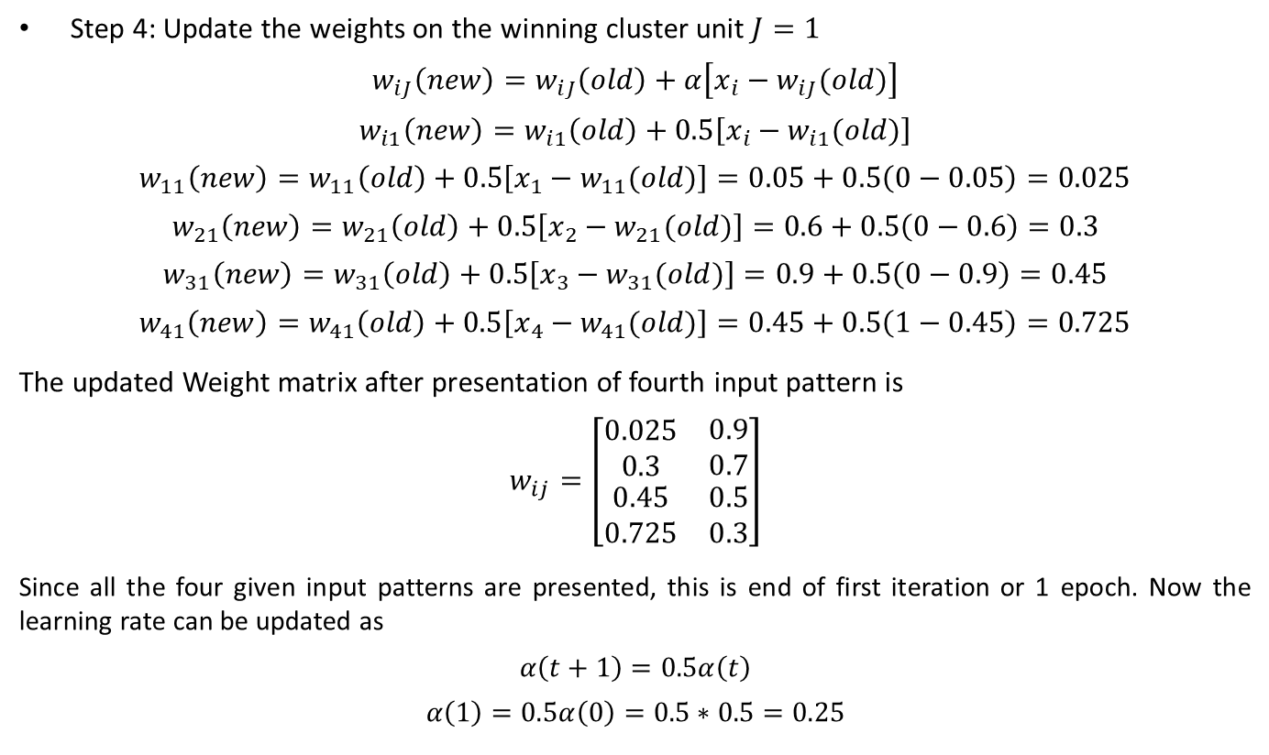
KSOFM (Example)
Step 4: Update the weights on the winning cluster unit $J=1$
$$w_{iJ}\left(new\right)=w_{iJ}\left(old\right)+α\left[x_{i}−w_{iJ}(old)\right]$$
$$w_{i1}\left(new\right)=w_{i1}\left(old\right)+0.5\left[x_{i}−w_{i1}(old)\right]$$
$$w_{11}\left(new\right)=w_{11}\left(old\right)+0.5\left[x_{1}−w_{11}(old)\right]=0.05+0.5\left(0−0.05\right)=0.025$$
$$w_{21}\left(new\right)=w_{21}\left(old\right)+0.5\left[x_{2}−w_{21}(old)\right]=0.6+0.5\left(0−0.6\right)=0.3$$
$$w_{31}\left(new\right)=w_{31}\left(old\right)+0.5\left[x_{3}−w_{31}(old)\right]=0.9+0.5\left(0−0.9\right)=0.45$$
$$w_{41}\left(new\right)=w_{41}\left(old\right)+0.5\left[x_{4}−w_{41}(old)\right]=0.45+0.5\left(1−0.45\right)=0.725$$
The updated Weight matrix after presentation of fourth input pattern is
$$w_{ij}=\left[\begin{matrix}\begin{matrix}\begin{matrix}0.025 \\ 0.3\end{matrix} \\ \begin{matrix}0.45 \\ 0.725\end{matrix}\end{matrix} & \begin{matrix}\begin{matrix}0.9 \\ 0.7\end{matrix} \\ \begin{matrix}0.5 \\ 0.3\end{matrix}\end{matrix}\end{matrix}\right]$$
Since all the four given input patterns are presented, this is end of first iteration or 1 epoch. Now the learning rate can be updated as
$$α\left(t+1\right)=0.5α\left(t\right)$$
$$α\left(1\right)=0.5α\left(0\right)=0.5∗0.5=0.25$$

Slide 62
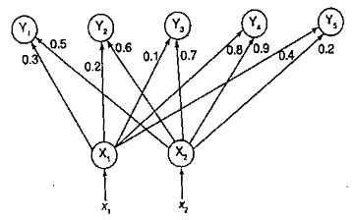
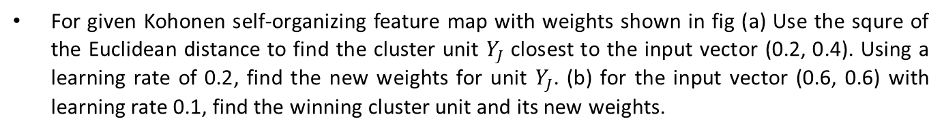
KSOFM (Example)
For given Kohonen self-organizing feature map with weights shown in fig (a) Use the squre of the Euclidean distance to find the cluster unit $Y_{J}$ closest to the input vector (0.2, 0.4). Using a learning rate of 0.2, find the new weights for unit $Y_{J}$. (b) for the input vector (0.6, 0.6) with learning rate 0.1, find the winning cluster unit and its new weights.

Slide 63

KSOFM (Example)
Solution:
For the input vector $(0.2, 0.4) =\left(x_{1},x_{2}\right)$ and $α=0.2$, the weight vector W is given by
$$W=\left[\begin{matrix}\begin{matrix}\begin{matrix}0.3 & 0.2\end{matrix} & 0.1 & \begin{matrix}0.8 & 0.4\end{matrix}\end{matrix} \\ \begin{matrix}\begin{matrix}0.5 & 0.6\end{matrix} & 0.7 & \begin{matrix}0.9 & 0.2\end{matrix}\end{matrix}\end{matrix}\right]$$
Now we find the winner unit using square of Euclidean distance, i.e.,
$$D\left(j\right)=\sum_{i=1}^{2}{{\left(w_{ij}−x_{i}\right)}^{2}}={\left(w_{1j}−x_{1}\right)}^{2}+{\left(w_{2j}−x_{2}\right)}^{2}$$
For $j=1 to 5$
$$D\left(1\right)={\left(0.3−0.2\right)}^{2}+{\left(0.5−0.4\right)}^{2}=0.01+0.01=0.02$$
$$D\left(2\right)={\left(0.2−0.2\right)}^{2}+{\left(0.6−0.4\right)}^{2}=0.0+0.04=0.04$$
$$D\left(3\right)={\left(0.1−0.2\right)}^{2}+{\left(0.7−0.4\right)}^{2}=0.01+0.09=0.1$$
$$D\left(4\right)={\left(0.8−0.2\right)}^{2}+{\left(0.9−0.4\right)}^{2}=0.36+0.25=0.61$$
$$D\left(5\right)={\left(0.4−0.2\right)}^{2}+{\left(0.2−0.4\right)}^{2}=0.04+0.04=0.08$$
Since $D\left(1\right)=0.02$ is the minimum value, the winner unit is $J=1.$We now update the weights on the winner unit $J=1$.

Slide 64

KSOFM (Example)
Solution:
The weight updation formula is given by,
$$w_{iJ}\left(new\right)=w_{iJ}\left(old\right)+α\left[x_{i}−w_{iJ}(old)\right]$$
Substituting $J=1$in the equation above, we obtain
$$w_{i1}\left(new\right)=w_{i1}\left(old\right)+α\left[x_{i}−w_{i1}(old)\right]$$
For $i=1 to 2$,
$$w_{11}\left(new\right)=w_{11}\left(old\right)+α\left[x_{1}−w_{11}(old)\right]=0.3+0.2\left(0.2−0.3\right)=0.28$$
$$w_{21}\left(new\right)=w_{21}\left(old\right)+α\left[x_{2}−w_{21}(old)\right]=0.5+0.2\left(0.4−0.5\right)=0.48$$
The updated weight matrix is given by
$$W=\left[\begin{matrix}\begin{matrix}\begin{matrix}0.28 & 0.2\end{matrix} & 0.1 & \begin{matrix}0.8 & 0.4\end{matrix}\end{matrix} \\ \begin{matrix}\begin{matrix}0.48 & 0.6\end{matrix} & 0.7 & \begin{matrix}0.9 & 0.2\end{matrix}\end{matrix}\end{matrix}\right]$$

Slide 65

KSOFM (Example)
Solution:
For the input vector $(0.6, 0.6) =\left(x_{1},x_{2}\right)$ and $α=0.1$, the weight vector W is given by
$$W=\left[\begin{matrix}\begin{matrix}\begin{matrix}0.3 & 0.2\end{matrix} & 0.1 & \begin{matrix}0.8 & 0.4\end{matrix}\end{matrix} \\ \begin{matrix}\begin{matrix}0.5 & 0.6\end{matrix} & 0.7 & \begin{matrix}0.9 & 0.2\end{matrix}\end{matrix}\end{matrix}\right]$$
Now we find the winner unit using square of Euclidean distance, i.e.,
$$D\left(j\right)=\sum_{i=1}^{2}{{\left(w_{ij}−x_{i}\right)}^{2}}={\left(w_{1j}−x_{1}\right)}^{2}+{\left(w_{2j}−x_{2}\right)}^{2}$$
For $j=1 to 5$
$$D\left(1\right)={\left(0.3−0.6\right)}^{2}+{\left(0.5−0.6\right)}^{2}=0.09+0.01=0.10$$
$$D\left(2\right)={\left(0.2−0.6\right)}^{2}+{\left(0.6−0.6\right)}^{2}=0.16+0.0=0.16$$
$$D\left(3\right)={\left(0.1−0.6\right)}^{2}+{\left(0.7−0.6\right)}^{2}=0.25+0.01=0.26$$
$$D\left(4\right)={\left(0.8−0.6\right)}^{2}+{\left(0.9−0.6\right)}^{2}=0.04+0.09=0.13$$
$$D\left(5\right)={\left(0.4−0.6\right)}^{2}+{\left(0.2−0.6\right)}^{2}=0.04+0.16=0.20$$
Since $D\left(1\right)=0.10$ is the minimum value, the winner unit is $J=1.$We now update the weights on the winner unit $J=1$.

Slide 66

KSOFM (Example)
Solution:
The weight updation formula is given by,
$$w_{iJ}\left(new\right)=w_{iJ}\left(old\right)+α\left[x_{i}−w_{iJ}(old)\right]$$
Substituting $J=1$in the equation above, we obtain
$$w_{i1}\left(new\right)=w_{i1}\left(old\right)+α\left[x_{i}−w_{i1}(old)\right]$$
For $i=1 to 2$,
$$w_{11}\left(new\right)=w_{11}\left(old\right)+α\left[x_{1}−w_{11}(old)\right]=0.3+0.1\left(0.6−0.3\right)=0.33$$
$$w_{21}\left(new\right)=w_{21}\left(old\right)+α\left[x_{2}−w_{21}(old)\right]=0.5+0.1\left(0.6−0.5\right)=0.51$$
The updated weight matrix is given by
$$W=\left[\begin{matrix}\begin{matrix}\begin{matrix}0.33 & 0.2\end{matrix} & 0.1 & \begin{matrix}0.8 & 0.4\end{matrix}\end{matrix} \\ \begin{matrix}\begin{matrix}0.51 & 0.6\end{matrix} & 0.7 & \begin{matrix}0.9 & 0.2\end{matrix}\end{matrix}\end{matrix}\right]$$

Slide 67


KSOFM (Example)
Consider a Kohonen self-organizing net with two cluster units and five input units. The weight vectors for the cluster units are given by
$$w_{1}=\left[\begin{matrix}\begin{matrix}1.0 & 0.9\end{matrix} & 0.7 & \begin{matrix}0.5 & 0.3\end{matrix}\end{matrix}\right]$$
$$w_{2}=\left[\begin{matrix}\begin{matrix}0.3 & 0.5\end{matrix} & 0.7 & \begin{matrix}0.9 & 1.0\end{matrix}\end{matrix}\right]$$
Use the square of Euclidean distance to find the winning cluster unit for the input pattern $x=\left[\begin{matrix}\begin{matrix}0.0 & 0.5\end{matrix} & 1.0 & \begin{matrix}0.5 & 0.0\end{matrix}\end{matrix}\right].$Using a learning rate of 0.25, find the new weights for the winning unit.

Slide 68

KSOFM (Example)
Solution:
The net can be formed as shown in figure. For the input vector $x=\left[\begin{matrix}\begin{matrix}0.0 & 0.5\end{matrix} & 1.0 & \begin{matrix}0.5 & 0.0\end{matrix}\end{matrix}\right]$ and the learning rate $α=0.25$, the weight vector W is given by
$$W=\left[\begin{matrix}\begin{matrix}\begin{matrix}1.0 \\ 0.9\end{matrix} \\ 0.7 \\ \begin{matrix}0.5 \\ 0.3\end{matrix}\end{matrix} & \begin{matrix}\begin{matrix}0.3 \\ 0.5\end{matrix} \\ 0.7 \\ \begin{matrix}0.9 \\ 1.0\end{matrix}\end{matrix}\end{matrix}\right]$$
Now we find the winner unit using square of Euclidean distance, i.e.,
$$D\left(j\right)=\sum_{i=1}^{2}{{\left(w_{ij}−x_{i}\right)}^{2}}$$
For $i=1 to 5$and $j=1 to 2$
$$D\left(1\right)={\left(1.0−0\right)}^{2}+{\left(0.9−0.5\right)}^{2}+{\left(0.7−1.0\right)}^{2}+{\left(0.5−0.5\right)}^{2}+{\left(0.3−0\right)}^{2}$$
$$=1+0.16+0.09+0+0.09=1.34$$
$$D\left(2\right)={\left(0.3−0\right)}^{2}+{\left(0.5−0.5\right)}^{2}+{\left(0.7−1.0\right)}^{2}+{\left(0.9−0.5\right)}^{2}+{\left(1.0−0\right)}^{2}$$
$$=0.09+0+0.09+0.16+1.0=1.34$$

Slide 69

KSOFM (Example)
As we can see, in this case $D(1)=D(2)$, so the winner unit is the one with the smallest index. Thus, winner unit is $Y_{1}$, i.e., $J=1$. we now update the weights on winner unit with $α=0.25$. The weight updation formula is given by,
$$w_{iJ}\left(new\right)=w_{iJ}\left(old\right)+α\left[x_{i}−w_{iJ}(old)\right]$$
Substituting $J=1$in the equation above, we obtain
$$w_{i1}\left(new\right)=w_{i1}\left(old\right)+α\left[x_{i}−w_{i1}(old)\right]$$
For $i=1 to 5$,
$$w_{11}\left(new\right)=w_{11}\left(old\right)+α\left[x_{1}−w_{11}(old)\right]=1+0.25\left(0−1\right)=0.75$$
$$w_{21}\left(new\right)=w_{21}\left(old\right)+α\left[x_{2}−w_{21}(old)\right]=0.9+0.25\left(0.5−0.9\right)=0.8$$
$$w_{31}\left(new\right)=w_{31}\left(old\right)+α\left[x_{3}−w_{31}(old)\right]=0.7+0.25\left(1.0−0.7\right)=0.775$$
$$w_{41}\left(new\right)=w_{41}\left(old\right)+α\left[x_{4}−w_{41}(old)\right]=0.5+0.25\left(0.5−0.5\right)=0.5$$
$$w_{51}\left(new\right)=w_{51}\left(old\right)+α\left[x_{5}−w_{51}(old)\right]=0.3+0.25\left(0−0.3\right)=0.225$$
The updated weights for winning unit is given by
$$w_{1}=\left[\begin{matrix}\begin{matrix}0.75 & 0.8\end{matrix} & 0.775 & \begin{matrix}0.5 & 0.225\end{matrix}\end{matrix}\right]$$
$$w_{2}=\left[\begin{matrix}\begin{matrix}0.3 & 0.5\end{matrix} & 0.7 & \begin{matrix}0.9 & 1.0\end{matrix}\end{matrix}\right]$$

